Slide 1

All Questions
Tell Me About Questions
Java Questions
Selenium Questions
SQL Questions
Framework Questions
Testing Questions
BackEnd Questions
Behavioral Questions
Java Technical Questions
‘How to handle…’ in Selenium
SQL Query Samples
OOP Questions
SDLC- Agile Questions
Jenkins – Git
Top Questions

Slide 2
Tell Me About Questions
12. Tell me about yourself
12. Tell me about your Project
13. Daily Activities
14. Role
15. Framework
16. Team Structure
17. Main Responsibility as an SDET?
18. Agile experience in your project?
265. Challenge you faced ?

Slide 3
Java Questions
22. JDK, JRE and JVM?
23. public static void main (String args[] )
24. Access Modifiers in Java?
47. Abstract Class vs Interface
25. Constructor vs Method?
177. Object vs Class?
42. Static keyword?
26. Local variable vs instance variable?
27. Set, List and Map in Java?
28. Arrays vs ArrayList
191. Overloading vs overriding
29. HashTable vs HashMap
30. HashMap vs HashSet
31. Error vs Exception
32. RuntimeException and CheckedException
33. Throw and Throws
34. How would you handle Exception?
35. Final vs Finalize vs Finally?
36. What is thread­safe or Synchronized?
37. Treeset vs TreeMap
38. equals() vs == in Java
39. String, String Builder, and String Buffer
40. Pass by value or pass by reference?
41. Break vs Continue
43. ‘this’ vs This()
44. base class, subclass, and superclass?
45. Array vs Vector
46. Vector vs Arraylist
48. ArrayList vs LinkedList
52. Java 7 vs Java 8

Slide 4
Selenium Questions
52. Advantages of Selenium?
53. Limitations of Selenium
54. Which tests can be automated
55. Which tests can not be automated
56. Locators
57. Xpath vs CSS
58. Locate element using text
59. Absolute (/) vs Relative (//)
60. close() and quit()
62. Implicit Wait vs Explicit Wait vs Fluent Wait
63. FindElement() and FindElements()
64. Exceptions
65. Selenium Grid
66. Assert (Hard Assert) vs Verify (Soft Assert)
67. Thread.sleep()
68. driver.get(). and driver.navigateto()
69. Listeners on Selenium
70. Challenges with Selenium?

Slide 5
‘How to handle…’ in Selenium
72. Dropdown in Selenium
73. Screenshot in Selenium
74. Tabs / Windows in Selenium
75. Alerts - Popups in Selenium
76. Actions Class
77. Download in Selenium
78. Uploading in Selenium
79. Headless Browser
80. Frames / iFrames
81. Move to ’n'th child element using XPath?
82. Move to parent element using Xpath
83. windows/OS popups?
84. handle dynamic elements
85. Maximize
86. scroll down a page using JavaScript in Selenium?
87. scroll down if the element is not visible
88. Reporting in Selenium
89. Handle in dynamic table in selenium?
90. Find all link present on the web page
91. Multiple windows in selenium?
92. Double click action
93. Https certificates
94. Js Alerts
95. Press ENTER key on text box in Selenium
96. Drag And Drop
97. Cookies

Slide 6
SQL Questions
102. What is SQL?
103. Do you know SQL?
104. What is a Database?
105. RDBMS?
106. Subsets / Categories of SQL?
107. SQL vs MySQL
108. What are constraints?
109. Clauses used with SELECT query in SQL
110. Joins
111. ‘BETWEEN’ vs ‘IN’ condition operators?
112. ‘HAVING’ Clause vs ‘WHERE’ Clause
113. Statements in SQL
114. DROP vs TRUNCATE statements?
115. DELETE vs TRUNCATE statements?
116. Data Types in SQL
117. CHAR and VARCHAR2 datatype in SQL
118. UNION vs UNION ALL ?

Slide 7
SQL Query Samples
120. select unique records from a table?
121. top 3 high paid employees?
122. third highest salary of employees
123. second highest salary of employees?
124. find lowest salaries?
125. employees whose salaries are below the average?
126. find names of employee start with ‘A’?
127. maximum salaries in each department?
128. duplicate names in employees?

Slide 8
Backend Questions
162. JDBC
163. What is API
164. RESTFul
165. How do you test Rest API?
166. HTTP methods in REST (CRUD)
167. Authentication vs Authorization
168. Serialization vs DeSerialization
169. Verify from back-end
170. Validate JSON Response
171. Status Codes in API
172. POST vs PUT
173. Swagger
174. Do you have API documentation website for your API?
175. Endpoint
176. Parameters (Path vs Query)
177. XML
178. JSON
179. SOAP vs RESTful
182. How do you read JSON data in Java?
183. End to End Testing Scenarios: UI, API, DB

Slide 9
Framework Questions
132. What is a Framework?
133. How java projects are made?
134. Popular Test Automation Frameworks?
135. Tell me about your framework
136. OOP in your framework?
137. Page Object Model (POM)
138. Cucumber
139. Components of Cucumber BDD?
140. Feature File
141. Step Definition
142. Runner Class
143. Report in Cucumber
144. How to see your reports in cucumber?
145. dryRun in Cucumber
146. Hooks in Cucumber
147. Re-run Failed Tests in Cucumber
148. How do you take screenshots in cucumber
149. Maven
150. Maven Lifecycle
152. Abstract Class in your framework
153. Maps in your framework
154. POJO
155. Scenario Outline vs Scenario?
156. Page Factory?
157. Utilities
158. Singleton in Framework
159. TestNG vs Junit
160. TestBase Class ?
161. Excel in Framework

Slide 10
OOP Questions
177. Object vs Class?
178. OOP principles?
179. Encapsulation and how did use it?
180. Abstraction?
181. Encapsulation vs Abstraction
182. Polymorphism
183. Inheritance
184. Polymorphism vs Inheritance
185. Abstract Class?
186. Interface?
187. Abstract Class vs Interface?
188. Abstract class in your project
189. Java does not support multiple inheritance?
191. overloading vs overriding
192. static binding vs dynamic/runtime binding

Slide 11
Testing Questions
194. Software Testing?
195. Why we test?
197. Test Plan?
198. Test Case?
199. When the testing starts?
200. Defect Life Cycle?
201. Epic, User stories & Tasks?
202. What is testing hierarchy?
203. Requirement Traceability Matrix (RTM)
204. Defect
205. What to do when you find a defect?
206. If Developer says not a defect, what to do?
207. When will you Automate?
208. When will you not Automate?
209. Debugging vs testing?
210. Peer review?
211. Who writes test plans and test cases?
212. Bug severity vs bug priority
213. System testing and integration testing?
214. Black box vs white box testing?
215. Front End Testing and Back End testing?
216. Functional testing & non-functional testing

Slide 12
Java Technical Questions
218. Even-Odd
219. Swap Numbers
220. Reverse String
221. Reverse Integer
222. Prime Numbers
223. String Palindrome
224. Integer Palindrome
225. Factorial
226. Sum of Digits
227. Fibonacci
228. FizzBuzz
229. Only Unique Letters
230. Remove Duplicates
231. Largest Number in Array
232. Armstrong Number
233. Diamond of Asterisks
234. Pyramid Of Numbers
235. Floyds Triangle
236. Anagram

Slide 13
SDLC- Agile Questions
238. SDLC and what is it used for?
239. Software Testing Life Cycle (STLC)
240. STLC vs SDLC
241. Validation and verification ?
242. Requirement document?
243. Where is the requirement coming from?
244. The requirement is good or bad?
245. Agile
246. Agile Framework?
247. Waterfall?
248. Agile methodology did you use in your previous projects ?
249. Relation between Agile and Scrum? What is Scrum?
250. Why do we need Agile? Waterfall and Agile?
251. Different roles in Scrum?
252. Describe a scrum team?
253. Scrum of scrums?
254. Burn-down and burn-up charts
255. Sprint?
256. Product backlog & Sprint Backlog?
257. Velocity of a sprint and how it is measured?

Slide 14
Behavioral Questions
259. Biggest Accomplishment?
260. Why did you apply for this position?
261. Where do you see yourself 5 years from now?
262. Why should we hire you?
263. Weakness?
264. Strength?
265. challenge you faced during your last project?
266. How do you handle stress? Or Conflict?
267. Can you start tomorrow?
268. What do you do if I hire you?
269. how long are you planning to stay?
270. Can you work under pressure?
271. What do you like the most about testing?
272. What to do in case of you have too much work and you can...
273. Do you have any question for us?

Slide 15
Jenkins - Git
283. Jenkins
284. Jenkins – How do you create a job?
285. Configure Jenkins
286. How does Jenkins work overall?
287. How about pipeline with Jenkins?
288. How many environment do you have?
289. How do you use Git?
290. Git Commends
291. Branching Strategy
292. AWS

Slide 16
Top Questions
Tell me about yourself
Tell me about your project
Framework
Daily Activities
Agile experience in project?
Challenge faced at project?
Object vs Class?
Overloading vs Overriding
Constructor vs Method?
Set, List and Map in Java?
equals() vs == in Java
Static keyword?
String, String Builder, and String Buffer
Abstraction?
Abstract Class vs Interface
Locators
Xpath vs CSS
Absolute (/) vs Relative (//)
Implicit Wait vs Explicit Wait vs Fluent Wait
Challenges with Selenium?
Alerts - Popups in Selenium
Frames / iFrames
JDBC
How do you test Rest API?
Status Codes in API
OOP in your framework?
Singleton in Framework
Jenkins
Git Commends
Branching Strategy
Do you have any question for us?

Slide 17
Tell Me About

Slide 18
Tell me about yourself
First of all, I would like to thank you for giving me this opportunity and I really appreciate for your time. My name is MSU. I have been in IT industry for more than 5 years. I am currently an automation engineer on my team.
I have gained domain knowledge in Aviation Industry and Logistics.
I have specialized in automation and also I'm comfortable with manual and back-end testing.
I have specialized in Selenium with Java Programming Language.
I develop my 'testing framework' based on POM (Page Object Model) that every page element go to one class and It makes easy to maintenance and keep my code organized and clean.
My framework supports BDD. I use Cucumber with Gherkin Language in feature file to make sure that my test cases are understandable for each member of my team.
I am good at core Java, Selenium, Maven, Cucumber, JUnit, TestNG, Jenkins, Jira, SQL, Git and many more tools for test automation. I use Maven to manage and centralize my dependencies which I have pom.xml. I have used Jenkins for continuous integration and to schedule my tests. I use Jira as bug management tool. I use SQL for back end testing. I use Git for version control. I have worked on API testing on my project and I used Restful, postman, and Rest Assured library.
I have a strong understanding of SDLC, and I am familiar with both Waterfall and Agile environment. I've certified Scrum Master and Oracle Java Programmer. I am proficient in various testing types, including like; functional, regression and smoke testing.
As far as soft skill concerned, I consider myself; A positive person, cross-functional team member. Quick learner and adaptable to changing circumstances. I can work well individually and in a team and I am cross-functional team member that is always willing to help my team in any way to achieve our sprint goal.
That is pretty much about myself. Thank you.

Slide 19
Tell me about your Project
Vytrack is a fleet management application
vehicle delivery
Vehicle rent for business use
Replacement vehicle
Damage Management
Vehicle Maintenance
Vehicle Insurance and Registration

Slide 20
Daily Activities
My daily activities at work, I go to work early in the morning and check result report of Smoke Test to make sure that environment is up and running and the application is stable or not for the day.
If something goes wrong, I will send out an email to my team so they can take care of it asap before everyone comes to work, to reach maximum productivity.
And then I check my email if there are any important tasks or notices, also check my schedule if there are any meetings for the day and also check Jira to review what needs to be done that day in which priority.
Then I go to attend daily standup meeting at 9:00 am. with my scrum team to talk about what we did yesterday, what we will do today and are there any impediments in my way. This meeting is simply to synchronize our team and it takes about 15 minutes.
After that, I go back to my desk and start automating test cases from regression suits. And also, I automate test cases from sprint backlog after doing manually if it is passed.
That is pretty much about my daily activities at work.

Slide 21
Role
As an automation engineer, I develop my ‘testing framework’ based on POM (Page Object Model). I performed various types of testing, like; functional testing, smoke testing, regression testing and back-end testing. I am responsible executing Regression test when developers add new functionality to the application or end of the sprints.
I am also responsible to check report of Smoke Test to make sure that environment is up and running first thing in the morning.
If there are any issues, I analyze them.
If it is service issue, I will immediately contact developers.
If it is about my scripts, I debug my scripts and fix it.
If it is a bug, I re-produce it and log the defect.
And also I am using Jira as bug management tool. Once the bug reports fixed by the developers, I re-test it and if it is passed I close it. If the defect is not fixed, I re-open it. Also, as a part of the Agile Scrum Team, I participate in the several walkthroughs meeting for the requirement reviews and provide valuable feedback to the BA. Lastly, I am cross-functional team member that is always willing to help my team in any way to achieve our sprint goal.
That is pretty much about my role as an automation engineer.

Slide 22
Framework
In my framework, I’ve developed my testing code using Java programming language and Selenium WebDriver. I used Maven to manage and centralize my dependencies which I have pom.xml.
My framework was structured based on the POM that every page element go to one class and it makes easy to maintenance and to keep my code organized and clean.
My framework supports Behavior Driven Development (BDD) and scenario outline. I use Cucumber with Gherkin Language in feature file to make sure that my test cases are understandable for each member in my team.
I am using Jira as bug management tool. And I achieve continuous integration and schedule my tests using Jenkins. I also use Apache POI with excel spreadsheets.
That is pretty much about my framework.

Slide 23
Team Structure
My team consist of adaptive, cross-functional and self-organized individuals that highly motivated and knowledgeable. We have 9 people in my team.
4 developers,
3 testers (1 manual tester - 2 automation),
1 Scrum Master,
1 PO.

Slide 24
Main Responsibility as an SDET?
Turn manually executed test scenarios into automatically executed test scenarios via a Selenium, Java and Cucumber testing framework and Gherkin.
Design and develop test plans that verify user stories and system requirements.
Develop and automate test cases to ensure what we build meets the highest levels of quality.
Functional Testing, Regression Testing, Smoke Testing

Slide 25
Agile experience in your most recent project?
Our sprint is 4 weeks and we have release every 3 sprints as a release cycle. We have 9 people in my team. 4 developers , 2 automation (Me) and 1 functional testers, also 1 SM and 1 PO.
We start a sprint with Sprint Planning Meeting and we learn the part of the application which we are going to develop. We get general idea than we do Sprint Grooming for giving some estimates for the tasks.
After sprint starts, we do Daily Standup Meeting everyday morning and we discuss what did we do yesterday, what will we do today and is there any blocker. Just we synchronize info about the sprint.
End of the sprint, usually we do Sprint Demo/Review Meeting . It is just to show customer what we build sprint (PO can put feedback) As an SDET in my team, I have done presentation sometimes and go over through the functionalities in the conference room. Client or stakeholders or business people they ask questions what they don’t know.
After Sprint Demo, we do Sprint Retrospective Meeting. In Sprint Retro, we talk about what was good in last sprint, what kind of mistakes we made. We go over them and make sure that we don’t make the same mistakes again. If we did something good , we would continue doing it.
This is pretty much our Sprint process

Slide 26
Java

Slide 27
JDK, JRE and JVM?
Java Virtual Machine: JVM is an abstract machine. It actually runs by Java code. Most people know Java with this slogan "Write once and run everywhere' This slogan is because of JVM.
Java Runtime Environment : JRE is what we need to run a Java program and contains set of libraries and other files that JVM uses at run time. JRE = JVM + Library Classes
Java Development Kit : JDK is what we need to compile Java source code and contains JRE, development tools. JDK = JRE + Development tools

Slide 28
public static void main (String args[] ) in Java
- public:
public is an access modifies which is used to specify who
can access this method. Public means that this method will be
accessible by any Class.
- static:
It is a keyword in java which identifies it is class bases i.e
it can be accessed without creating the instance of a class
- void:
it is the return type of the method void defines the method which
will not return any value
- main:
it is the name of the method which is searched by JVM as a
starting point for an application with a particular signature only.
it is the method where the main executions occurs
- String args:
it is the parameter passed to the main method

Slide 29
Access Modifiers in Java?
In Java, access modifier which specifies accessibility of class, methods and variables. There are four access modifier in Java namely Public, Private, Protected and Default. The difference between these access modifies is that; The most importantly is the level of accessibility.
Public is accessible to anywhere
Private is only accessible in the same class which is declared.
Default is accessible only inside the same package.
Protected is accessible inside the same package and also outside the package but only the child classes. We cannot use private or protected modifier with a top­ level class.

Slide 30
Constructor vs Method?
Constructor is a special method in the class that is executed whenever object is created. Doesn’t have a return type and constructor’s name must be same as the class name.
Constructor is called automatically when a new object is created.
Constructor is invoked implicitly.
The Java compiler provides a default constructor if we don’t have any constructor.
Constructors are not inherited by child classes
Method: Collection of statements that are grouped together to perform an operation.
Method have a return and the method’s name may or not be same as the class name.
Method is invoked explicitly.
Method is not provided by compiler in any case. Methods are inherited by child classes.

Slide 31
local variable vs instance variable?
In Java, a local variable is typically used inside a method, constructor, or a block and has only local scope. Thus, this variable can be used only within the scope of a block. The best benefit of having a local variable is that other methods in the class won’t be even aware of that variable.
Whereas, an instance variable in Java, is a variable which is bounded to its object itself. These variables are declared within a class, but outside a method. Every object of that class will create it’s own copy of the variable while using it. Thus, any changes made to the variable won’t reflect in any other instances of that class and will be bound to that particular instance only.

Slide 32
Set, List and Map in Java?
Set, List and Map are 3 important interface of Java collection framework.
Set provides un­ordered collection of unique objects. Set doesn’t allowed duplication. List and Set are both extend collection interface.
- SET : - can only store unique values.
- set does not maintain order
- set allows only 1 null
- Comes from collection interface
- set doesnt allow that
List provides ordered and indexed collection which may contain duplication.
- LIST: - can store duplicate values,
- maintains /keeps the insertion order
- list allows any number of null values
- Comes from collection interface
- from list we can read a certain value by index Map provides a data structure based on Key Value. Key is always unique, value can be dupl.
- MAP : is a key+value format and keys are always unique
- map read value by passing key
- map can have single null key but multiple null values

Slide 33
Arrays vs ArrayList
Array is a part of core Java programming and has special syntax. ArrayList is part of collection framework and implement List interface.
Major difference is that; Array is a fixed length data structure, so we can change length of Array one created, ArrayList is re­-sizeable.
The other major one is that Array can contain both primitives and objects. ArrayList can only contain objects. It cannot contain primitive types.
Also, we can compare Array and ArrayList on how to calculate length of Array or size of ArrayList. We use length for an Array, we use size() method for an ArrayList.

Slide 34
Hashtable vs HashMap
Both HashTable and HashMap implements Map interface
Both key + value
Hashtable: its synchronized, no null keys or values
HashMap is not thread-safe while HashTable is a thread­-safe collection.
HashMap: Not Synchronized, only 1 null key and multiple null values
Second important difference is performance since HashMap is not synchronized. It performed better than HashTable
→ Collections.synchronizedMap (...Map...);

Slide 35
HashSet vs HashMap
HashSet stores unique elements
HashSet implements Set
HashSet stores Single Objects
HashMap stores unique keys, and duplicated values
HashMap implements Map
HashMap stores Key, Value paired objects

Slide 36
Error vs Exception
Both Error and Exception are derived from Throwable in Java. Error represent errors which are generally can not be handled. For examples: OutOfMemoryError, NoClassDefFoundError
On the other hand, Exception represent errors which can be catch and dealt.
For examples : IOException, NullPointerException Exception is divided in two categories checked and unchecked Exception. Checked Exception require a mandatory try­catch code block to handle it. Unchecked Exception mostly represent programming errors ( NullPointerException or RuntimeException)

Slide 37
Runtime Exception and Checked Exception
Exception are divided in two categories
Runtime (unchecked) Exception and CheckedException.
Main difference between RuntimeException and CheckedException is that, it is mandatory to provide try­catch to handle CheckedException while in case of RuntimeException is not mandatory.
Some of the most common Exception like NullPointerExceptio, ArrayIndexOutOfBound, ClassNotFoundException, IOException.

Slide 38
Throw and Throws
Throw and throws are two keyword related to Exception feature of Java programming language.
THROW : -> CREATES AN EXCEPTION OBJECT
throw new RuntimeException();
THROWS -> goes to method signature, And declares that a method might throw And exception
throw keyword is used to throw an exception explicitly, on the other hand, throws keyword is used to declare an exception which means it works similar to the try­catch block.
If we see syntax wise than throw is followed by an instance of Exception class throws is followed by exception class names.
throw new ArithmeticException (“Arithmetic Exception”);
throws ArithmeticException;
throw keyword is used to method body, while throws is used in method signature to declare the exception.

Slide 39
How would you handle Exception?
try­catch blocks is placed around the code that might generate an exception. Every try block should be followed either by catch or finally block.
the finally block follows a try block or a catch block. Finally block always executes, no matter what happened.
throws keyword: If a method does not handle a checked exception, the method must declare it using the throws keywords which appears at the end of method’s signature.
throw keyword: We can throw an exception by using the throw keyword inside method body

Slide 40
Exception Handling in Java
- Depending on situation, we can use try catch finally blocks.
TRY : Code that might throw some exception
CATCH: We define exception type to be caught
And what to do if exception happens in TRY block code
FINALLY: Code that always runs , regardless if there is Exception or no.
FINALLY block: WILL NOT RUN if JVM crashes, or System.exit(0) Is present
in try or catch blocks. Clean up code, to close some connections, close
open files etc

Slide 41
Final vs Finalize vs Finally?
final is a keyword and used to apply restrictions on class, method and variable. (final class cannot be inherited, final method cannot be overridden and final variable value cannot be changed.)
- final is a keyword
- final is used to apply restriction on class method and variable
- if a class is marked as final then this class can not be inherited
by any other class
finally is a block and used to place important code, it will be executed whether exception is handled or not.
- finally is a block
- finally is a block which is used for exception handling along with
try and catch blocks
finalize is a method and used to perform clean up processing before object is garbage collected.
- finalize() method is protected method of java.lang.object class
it is inherited to every class you create in java
- finalize() methos id used to perform some clean up operations
on a object before it is removed from memory

Slide 42
What is thread­safe or Synchronized?
A sequential or single threaded program has single flow ­ synchronized: Means that two threads can not execute the method or access the variables at the same time and the JVM takes care of enforcing that. it is used to achieve thread­safety

Slide 43
Treeset vs TreeMap
TreeSet: Can contain only unique values ­ is sorted in ascending order
TreeMap: can contain only unique keys. ­ keys are sorted in ascending order

Slide 44
equals() vs == in Java
Equals() method is defined in Object class in Java and used for checking equality of two objects defined by business logic.
“==” or equality operator in Java is a binary operator provided by Java programming language and used to compare primitives and objects. public boolean equals(Object o) is the method provided by the Object class. The default implementation uses == operator to compare two objects. For example: method can be overridden like String class. equals() method is used to compare the values of two objects.

Slide 45
String, String Builder, and String Buffer
String: Immutable. String variables are stored in “constant string pool”. Once the string reference changes the old value that exists in the “constant string pool”, it cannot be erased.
String Buffer: Mutable. Here string values are stored in a stack. If the values are changed then the new value replaces the older value. The string buffer is synchronized which is thread-safe. Performance is slower than the String Builder.
String Builder: Mutable. This is same as String Buffer except for the String Builder which is not threaded safety that is not synchronized. So obviously performance is fast.

Slide 46
Java pass by value or pass by reference?
- Java is a “pass-by-value” language. This means that a copy of the variable is made and themethod receives that copy. Assignments made in the method do not affect the caller.
Passing by value means that the value of the function parameter is copied into another location of your memory, and when accessing or modifying the variable within your function, only the copy is accessed/modified and the original value is left untouched. Passing by value is how your values are passed on most of the time.
Passing by reference means that the memory address of the variable (a pointer to the memory location) is passed to the function. This is unlike passing by value, where the value of a variable is passed on. In the examples, the memory address of myAge is 106. When passing myAge to the function increaseAgeByRef, the variable used within the function (age in this example) still points to the same memory address as the original variable myAge (Hint: the & symbol in front of the function parameter is used in many programming languages to get the reference/pointer of a variable).

Slide 47
Break vs Continue
break leaves a loop, continue jumps to the next iteration.

Slide 48
Static keyword?
Static means: you can access them without creating an object, just by using a classname.
Static members belong to class itself, they are also called class members.
Static keyword means that the variable or method belongs to class and shared between all instances.
We can call static members by using class name or object
Static methods can not call/refer Non Static members
What can be static?
Static can be: variables, method, block, inner class
static variables -> is also called <shared variable>, it will have only one copy of it. every object of the class will share the value of it.
static methods -> a method that can be called using a classname, without creating an object
-> objects can also call static methods.
-> static methods can only access other static variables or methods.
-> static methods cannot call/use instance variables
static blocks -> code in static block executes only ONCE and BEFORE EVERYTHING ELSE,
whenever the class is used.
static inner/nested classes

Slide 49
‘this’ vs This()
this keyword => refers to this instance/object of the class.
this.name ==> name instance variable of this current object.
return this; ==> it means return same object.
this() keyword with parenthesis ==> If in your class, you have multiple constructors, you can call one constructor from another one, using This() keyword. This() keyword must be the first statement in the calling constructor.

Slide 50
base class, subclass, and superclass?
subclass (child) - the class that inherits from another class
superclass (parent) - the class being inherited from
Base Class is the Parent. - Subclass is the Child.

Slide 51
Array vs Vector

Slide 52
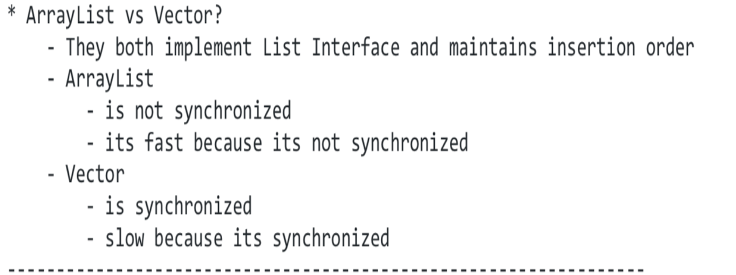
Vector vs Arraylist

Slide 53
Abstract Class vs Interface
A class that is declared with abstract keyword, is known as abstract class. It can have abstract and non abstract methods.
An Interface is a blueprint of a class. It is a template and it is declared with interface keyword. It can have abstract methods, default methods, static methods and public final static variables
When we want to use Abstract class, we use “extend” keyword.
When we want to use Interface, we use “implement” keyword.
Abstract class and interface both are used to achieve abstraction.
Both cannot be instantiated, we cannot create an object.

Slide 54
ArrayList vs LinkedList
ArrayList | LinkedList
1) ArrayList internally uses a dynamic array to store the elements. | LinkedList internally uses a doubly linked list to store the elements.
2) Manipulation with ArrayList is slow because it internally uses an array. If any element is removed from the array, all the bits are shifted in memory. | Manipulation with LinkedList is faster than ArrayList because it uses a doubly linked list, so no bit shifting is required in memory.
3) An ArrayList class can act as a list only because it implements List only. | LinkedList class can act as a list and queue both because it implements List and Deque interfaces.
4) ArrayList is better for storing and accessing data. | LinkedList is better for manipulating data.

Slide 55
Java 7 vs Java 8
JAVA 7 vs JAVA 8
- String in - Lambda Expression
Switch statement - pipelines and Streams
- Multiple Exeception - date and time API
Handling - Java 8 interface changes
Static Method, Default Method

Slide 56
Selenium

Slide 57
Advantages of Selenium?
Selenium is a suite of tools for automated web testing.
Selenium is open source and free to use without any licensing cost
It supports multiple languages like Java, Ruby, Python, C#...
It supports multi­ browser testing
It has a good amount of resources and helping community
It supports many operating systems like Windows, Mac, Linux ...
Interact with the web application

Slide 58
Limitations of Selenium
Selenium supports testing of only web-based applications
Mobile applications cannot be tested using Selenium
Captcha and Barcode readers cannot be tested using Selenium
Reports can only be generated using third-party tools like TestNG or JUnit.
As Selenium is a free tool, thus there is no ready vendor support through the user can find numerous helping communities.
The user is expected to possess prior programming language knowledge.

Slide 59
Which tests can be automated
functional tests (positive/negative, UI)
smoke tests
regression tests
integration tests
API
Database
end to end testing
data driven

Slide 60
Which tests can not be automated
Performance, load, stress testing, manual ad hoc testing, (These tests are done by experts trained in these tools)
Pure database testing (if we only test the DB itself),
Unit tests..., look and feel based testing (color, shapes, etc.),
static testing

Slide 61
Locators
A locator is an address that uniquely identifies a web element within a web page. Selenium has several different types of locators to identify web elements in web pages. These include:
ID: Unique for every web element
Name: Same as ID although it is not unique
CSS Selector: Works on element tags and attributes
XPath: Searches elements in the DOM, Reliable but slow
Class name: Uses the class name attribute
TagName: Uses HTML tags to locate web elements
LinkText: Uses anchor text to locate web elements
Partial Link Text: Uses partial link text to find web elements

Slide 62
Xpath vs CSS
with Xpath, we can search elements backward or forward...
works with text
supports index
xpath has more conbination so its powerful but it can get ugly.
Xpath syntax: //tagname[@id='value']
while Css works only in forward direction
does not support text
does not support index
fast easy to read and write,
Css syntax: tag name[id=value]

Slide 63
Locate element using text
The only locator that works with text is xpath.
Matching exact text: //tag[.=‘text’]
Matching partial text: //tag[contains(text(), ’text’)]

Slide 64
Absolute (/) vs Relative (//)
Absolute xPath starts with 1 slashes (/) and it starts looking for element starting from the root element.
Relative xPath starts with double slashes (//) and it starts looking for element starting anywhere in the document.
Single slash (/) is used to create Xpath with an absolute path. In this case, the Xpath starts selection from the document start node.
Double slash (//) is used to create Xpath with a relative path. In this case, the Xpath starts selection from anywhere within the document.
Syntax —> //tagname[@attribute=`value`]

Slide 65
close() and quit()
driver.close() —>used to close the currentbrowser
Close —> only closes the current tab
driver.quit() —>used to close all the browser instances
Quit —> closes all browsers, tabs, windows, every thing that was opened with selenium

Slide 66
Implicit Wait vs Explicit Wait vs Fluent Wait
Implicit wait —> we use this wait when find elements. It works with findELement method. We set it one time using driver.manage().timeouts().implicitlywait(5, days)
Explicit wait —> we use this wait for wait for certain actions to happen. We call this every time when we want to wait. We use WebDriverWait class for this
WebDriverWait wait = new WebDriverWait(driver, 5); wait.until(ExpectedConditions.visibilityOf(element));
Fluent wait —> it is like explicit wait but more customizable version. For example using fluent wait we can ignore certain exceptions.

Slide 67
FindElement() and FindElements()
FindElement ­> this method returns first WebElement !
gives Exception if the element not found
FindElements ­> returns List <WebElement>;
does not give Exception if the element not found as a result list has null values

Slide 68
Exceptions
The most common exceptions in Selenium are:
TimeoutException: This exception is thrown when a command performing an operation does not complete in the stipulated time
NoSuchElementException: This exception is thrown when an element with given attributes is not found on the web page
ElementNotVisibleException: This exception is thrown when the element is present in DOM (Document Object Model), but not visible on the web page
StaleElementException: This is thrown when the element is either deleted or no longer attached to the DOM

Slide 69
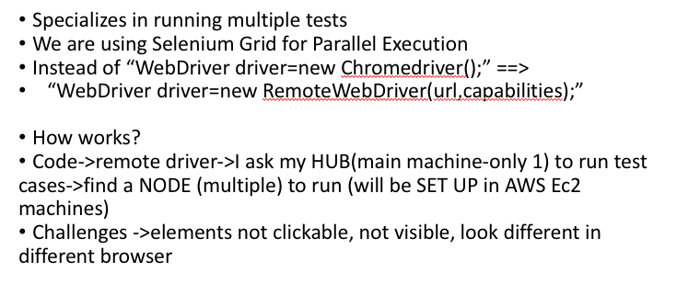
Selenium Grid

Slide 70
Assert (Hard Assert) vs Verify (Soft Assert)
When Assert fails the test is aborted, so when assertion fails all test steps after that line of code are skipped.
When verify command fails the test will continue executing but it will log the failure regardless is true or false.

Slide 71
Thread.sleep()
Slows down selenium to catch up
Throws exception so must handle it or throw it

Slide 72
driver.get(). and driver.navigateto()
driver.get() → To open an URL and it will wait till the whole page gets loaded
driver.navigateto() → To navigate to an URL and it will not wait till the whole page get loaded

Slide 73
Listeners on Selenium
Listener is defined as interface that modifies the default TestNG's behavior. As the name suggests Listeners "listen" to the event defined in the selenium script and behave accordingly. It is used in selenium by implementing Listeners Interface. It allows customizing TestNG reports or logs. There are many types of TestNG listeners available.
The types of Listeners in TestNG are,
IAnnotationTransformer
IAnnotationTransformer2
IConfigurable
IConfigurationListener
IExecutionListener
IHookable
IInvokedMethodListener
IInvokedMethodListener2
IMethodInterceptor
IReporter
ISuiteListener
ITestListener

Slide 74
Challenges with Selenium?
Sync issue
Sync issue or I would say timeout issue is one of the most challenging tasks in any test automation tool. If we do not handle sync issue then most of the script will fail. In one of the test survey, it as found that 80% of scripts fail due to improper syn while performing actions.
We can avoid this by using smart wait which is present in Selenium like implicit wait, explicit wait, fluent wait
Smart locators –locating elements
As we all know that locators are the core part of any scripting and We need to keep on enhancing our XPath and CSS for script stability because if XPath and CSS are not proper then it fails in upcoming releases.
We should always write dynamic or custom XPath or class which can make our script more stable.
Pop up handling
In many application, you will find random pop keeps coming and their behavior is not persistence so we also have to take care of these unwanted pop up which stops our execution.

Slide 75
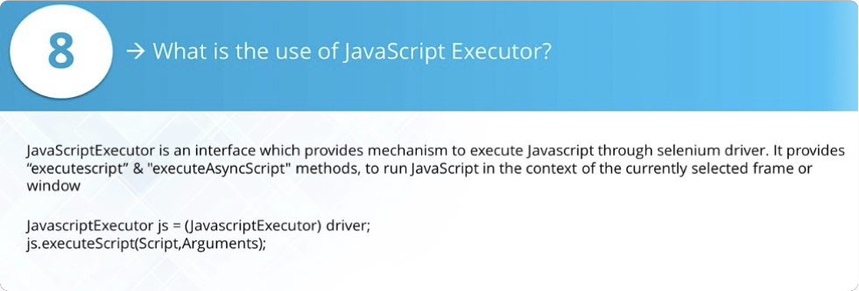
JavaScript Executor

Slide 76
‘How to handle…’ in Selenium

Slide 77
Dropdown in Selenium
- select class is used to deal with drop down list in selenium.
to create a select object we need to pass a webElement as
constructor. that element must have the select tag
- select by Index: Takes a int param, selects based on the index
0 based.
- select by visible text: takes a string, select based on the
text displayed.
- select by value: takes a string parameter selects based on
the value attribute of the option
- example: WebElement element = driver.findelement(by.id"dropdown")
Select list = new Select (element)
list.getFirstSelectedOption;

Slide 78
Screenshot in Selenium
You can take a screenshot by using the TakeScreenshot function.
By using getScreenshotAs()method you can save that screenshot.
Example: File scrFile = ((TakeScreenshot)driver).getScreenshotAs(output Type.FILE);

Slide 79
Tabs / Windows in Selenium
- to handle separate tabs/ windows we have to switch to that tab
- web driver handles one page html document at a time to control another tab we always need to switch
- to be able to switch we need to get the window handle first
using getWindowHandesl() method
- driver.switchTo.window() : takes a string -> window handle
- for each : driverGetWindowHandles:
driver.switchTo.window("title")
if driver.getTitle == expected title
break;
- selenium needs the windows handle to switch tabs it doesn not
use the title. to switch using title we still switch using the
window handle first then check the title.

Slide 80
Alerts - Popups in Selenium
void dismiss() —>clicks on the “Cancel” button as soon as the pop-up window appears.
void accept() —>clicks on the “Ok” button as soon as the pop-up window appears.
String getText() —>returns the text displayed on the alert box.
void sendKeys(String stringToSend) —>enters the specified string pattern into the alert box.

Slide 81
Actions Class
Actions class is used for advanced mouse and keyboard interactions:
Hover over element / move to element
Scroll up/down
Double click
Right click
drag and drop
keyboard conbinations
Actions actions = new Actions (driver) actions.moveTo(element).perform();

Slide 82
Download in Selenium
Selenium itself cannot verify file downloads, can click on download link but can't go outside the browser and open the downloaded file
Other tools need to be used for that Robot and AutoIT

Slide 83
Uploading in Selenium
in order to upload file using selenium we need to locate the upload button in html. the element will have tag input then we do sendKeys by passing the path to file which
To upload file in selenium we ...
1. Locate the element which takes the path of the file (Choose file button)
WebElement input = driiver.findElement(“id”);
2. Provide the path to the file using the sendKeys method
input.sendKeys(“/path/to/file”)

Slide 84
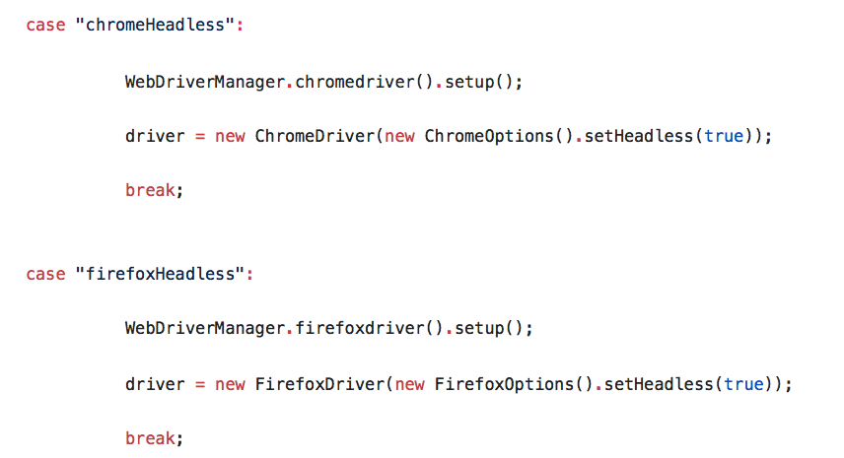
Headless Browser
Headless browser: browser that does not open, it runs as a background service / program.
Yes, I can do headless testing. I have a driver utility that can open different browsers including headless browsers:

Slide 85
Frames / iFrames
If we want to interact with elements inside frames/iframes, we have to switch to that frame first. Otherwise we get no such element exception.
We can switch frames using 3 options.
1. driver.switchTo().frame(“id or name”) —> using the name or id of the element
2. driver.switchTo().frame(index) —> using the index of the frame stars with 0
3. driver.switchTo().frame(webelement) —> locate the frame element using the findElement method and pass as param to the driver.switchTo().frame method
driver.switchTo().defaultContent(); -->> Back to original driver.switchTo().parentFrame(); —>> go bak to previous frame

Slide 86
move to ’n'th child element using XPath?
There are two ways:
using square brackets with index position For ex: div[2] will find the second div element
using position ( ) method For ex:div[position()=2] will find the second div element

Slide 87
Move to parent element using XPath
Using (..) expression in xpath, we can move to parent element

Slide 88
windows/OS popups?
Selenium doesn’t support windows-based apps, it is an automation testing tool that supports only web application testing. We could handle windows-based popups in Selenium using some third-party tools such as AutoIT, Robot class
driver.getWindowHandle() —>This will handle the current window that uniquely identifies it within this driver instance.
driver.getWindowHandles() —> To handle all opened windows

Slide 89
handle dynamic elements
Find the static part of the id and write a locator(xpath or css) → And then use Startswith, contains, EndsWith
contains( ) → //*[contains(@name=`btn`)]
start­with( ) → //label[start­with(@id, `message`)]
text( ) → //td[text() = `usedId`]
or & and → //input[@type = `submit` AND @name = `login`]

Slide 90
Maximize
To maximize the size of browser window, we can use the following piece of code:
driver.manage().window().maximize(); – To maximize the window

Slide 91
scroll down a page using JavaScript in Selenium?
We can scroll down a page by using window.scrollBy() function. Example:
((JavascriptExecutor) driver).executeScript("window.scrollBy(0,500)");

Slide 92
scroll down if the element is not visible
WebDriver driver = new FirefoxDriver(); JavascriptExecutor jse =
(JavascriptExecutor)driver; jse.executeScript('window.scrollBy(0,250)', '');
OR, we can do as follows: → jse.executeScript('scroll(0, 250);');

Slide 93
Reporting in Selenium

Slide 94
Handle in dynamic table in selenium?
Use custom xpaths and css locators
○ Xpath: contains, starts with, ends with, contains text.
○ By finding the element in relation to another stable element using parent, child, sibling relationships
I have utility methods that work with table. I have method that takes a table webelement and returns all the column names. I have a method that takes a table, number and returns all the data in that row.

Slide 95
Find all link present on the web page
List<WebElement> list =
driver.findElements(By.tagName(“a”));

Slide 96
Multiple windows in selenium?
Selenium stays on one window
If you open a window and then 5 tabs popped open, selenium is focused on the first window
If you are on a new window and you tell selenium to print an element on the default window, it will still work even that user’s
focus is on the new window
Must switch to new window
○ Use windowHandle()
○ Driver.getWindowHandle()
■ Everytime Selenium opens a browser, it's going to give an index ID for the page ­ called Handles
■ Returns the handle/id of current page (as a string)
○ driver.switchTo().window(string handle)
○ driver.getWindowHandles() ­ for multiple windows
Returns a Set of window handles
○ Switch using titles
for(string handle:
driver.getWindowHandles()){
driver.switchTo().Window(handle)
if(driver.getTitle().equals(targetTitle)
Break;

Slide 97
Double click action
To perform any actions against web element using actions class, we need to locate the element first:
WebElement el = driver.findElement
Actions actions = new Actions (driver).perform actions.doubleClick(el).perform()
actions.moveTo(el).perform actions.doubleClick.perform actions.moveTo(el).doubleClick().build.perform()

Slide 98
Https certificates
CHROME, IE → DesiredCapabilities capability = DesiredCapabilities.chrome();

Slide 99
Js Alerts
If the alert on the browser comes from JavaScript, we use the Alert class.
Alert alert = driver.switchTo.alert();
alert.accept();
alert.dismiss();
alert.sendKeys();
alert.getText();

Slide 100
Press ENTER key on text box in Selenium
To press Enter key using Selenium WebDriver,
We need to use Selenium Enum keys with its constant Enter
Driver,findElement(By.xpath(“xpath”)).sendKeys(Keys.ENTER);

Slide 101
Drag And Drop
Actions action = new Actions(driver);
action.clickAndHold(driver.findElement(By.xpath('//*[@id='draggable']')))
.moveToElement(driver.findElement(By.xpath('//*[@id='droppable']')))
.release() .build()
.perform();

Slide 102
Cookies

Slide 103
SQL

Slide 104
What is SQL?
SQL stands for Structured Query Language. It is the standard language for relational database management systems. It is especially useful in handling organized data comprised of entities (variables) and relations between different entities of the data.

Slide 105
Do you know SQL?
Yes, I am very comfortable with writing SQL Queries and DDL and DML commands. Currently working with Oracle database that is running in AMAZON CLOUD SERVER. DDL (Data definition language) : CREATE , ALTER, DROP, TRUNCATE DML(Data manipulation language): SELECT, DELETE, INSERT, UPDATE

Slide 106
What is a Database?
A database is an organized collection of data, stored and retrieved digitally from a remote or local computer system. Databases can be vast and complex, and such databases are developed using fixed design and modeling approaches.

Slide 107
RDBMS?
Relational Database Management System
Data is organized into tables that are related to each other
○ How are they related? ■ Primary Key (unique and not NULL)
and Foreign Key (duplicate and NULL) ○ What type of database system you have
expertise with? ■ RDBMS, such as SQL and Oracle

Slide 108
Subsets / Categories of SQL?
DDL (Data Definition Language) – It allows you to perform various operations on the database such as CREATE, ALTER and DELETE objects.
DML ( Data Manipulation Language) – It allows you to access and manipulate data. It helps you to insert, update, delete and retrieve data from the database.
DCL ( Data Control Language) – It allows you to control access to the database. Example – Grant, Revoke access permissions.
TCL (Transaction Control Language) - TCL statements allow you to control and manage transactions to maintain the integrity of data within SQL statements.

Slide 109
SQL vs MySQL
SQL is a standard language for retrieving and manipulating structured databases. On the contrary, MySQL is a relational database management system, like SQL Server, Oracle or IBM DB2, that is used to manage SQL databases.

Slide 110
What are constraints?
Properties that table column must comply with.
Columns have constraints that defined how data can be stored.
Primary Key: unique and NOT NULL Foreign Key: duplicate and NULL and cannot add
data which is not in PK Unique Key: only unique value Null: can have null Not null: cannot have null

Slide 111
Common clauses used with SELECT query in SQL
SQL clause helps to limit the result set by providing a condition to the query. A clause helps to filter the rows from the entire set of records. For example – WHERE, HAVING clause.
Some common SQL clauses used in conjuction with a SELECT query are as follows:
WHERE clause in SQL is used to filter records that are necessary, based on specific conditions.
ORDER BY clause in SQL is used to sort the records based on some field(s) in ascending (ASC) or descending order (DESC). GROUP BYclause in SQL is used to group records with identical data and can be used in conjuction with some aggregation functions to produce summarized results from the database. HAVING clause in SQL is used to filter records in combination with the GROUP BY clause. It is different from WHERE, since WHERE clause cannot filter aggregated records.

Slide 112
Joins
A JOIN clause is used to combine rows from two or more tables, based on a related column between them. It is used to merge two tables or retrieve data from there. There are 4 joins in SQL namely:
Inner Join is used when retrieving data from multiple tables and will return only matching data
Right Join is used when retrieving data from multiple tables and will return right table and any matching left table records. Left Join is used when retrieving data from multiple tables and will return left table and any matching right table records.
Full Join is used when retrieving data from multiple tables and will return both table records, matching and non­matching.

Slide 113
‘BETWEEN’ vs ‘IN’ condition operators?
BETWEEN operator is used to display rows based on a range of values in a row whereas the IN condition operator is used to check for values
contained in a specific set of values.
Example of BETWEEN: SELECT * FROM Students where ROLL_NO BETWEEN 10 AND 50;
SELECT * FROM students where
ROLL_NO IN (8,15,25);

Slide 114
‘HAVING’ Clause vs ‘WHERE’ Clause

Slide 115
Statements in SQL

Slide 116
DROP vs TRUNCATE statements?

Slide 117
DELETE vs TRUNCATE statements?

Slide 118
Data Types in SQL
number(num) - whole numbers up to num digits
number(num,num2) - num whole numbers up to num2 decimals
char(num) - fixed length character/string
varchar2(num) - used for varying length data
date - full date
currency - used for prices

Slide 119
CHAR and VARCHAR2 datatype in SQL

Slide 120
UNION vs UNION ALL ?

Slide 121
SQL Query Samples

Slide 122
select unique records from a table?
You can select unique records from a table by using the DISTINCT keyword.

Slide 123
top 3 high paid employees?
In mySQL **oracle has ROWNUM
SELECT salary, first_name, last_name FROM employees
ORDER BY salary DESC LIMIT 3;

Slide 124
third highest salary of employees
SELECT TOP 1 salary FROM( SELECT TOP 3 salary FROM employee_table ORDER BY salary DESC) AS emp ORDER BY salary ASC;

Slide 125
second highest salary of employees?
SELECT MAX(salary) FROM employees
WHERE salary NOT IN (SELECT MAX(salary) FROM employees);

Slide 126
find lowest salaries?
SELECT first_name, last_name, salary, job_id FROM employees WHERE salary = (SELECT MIN(salary) From employees);

Slide 127
employees whose salaries are below the average?
SELECT first_name, salary FROM employees
WHERE salary<= (SELECT AVG(salary) FROM employees);

Slide 128
find names of employee start with ‘A’?
SELECT * FROM Employees WHERE EmpName like 'A%' ;

Slide 129
maximum salaries in each department?
SELECT first­name, MAX(salary) FROM department d LEFT OUTER JOIN employee e ON (d.department_id = e.department_id) GROUP BY department_id;

Slide 130
duplicate names in employees?
SELECT first_name, COUNT (first_name) FROM employees GROUP BY first_name HAVING (COUNT(first_name>1);

Slide 131
Framework

Slide 132
What is a Framework?
A framework defines a set of rules or best
practices which we can follow in a systematic way to achieve the desired results. In test automation, framework is the blueprint of test automation.
It includes your folder structures, where to save you function library, test results, test data, resources. It is essential because when you are working on a automation project everyone will have a guideline to follow and our script will be easier to maintain.

Slide 133
How java projects are made?
1. Create folders/packages 2. Add libraries/dependencies 3. Create class files 4. Compile 5. Run tests 6. Deploy

Slide 134
Popular Test Automation Frameworks?
There are different types of test automationframeworksand the most common ones are:
Modular Testing Framework
Data Driven Testing Framework
Keyword Driven Testing Framework
Hybrid Testing Framework
Behavior Driven Development Framework

Slide 135
Tell me about your framework
In my recent VyTrack automation framework, we used Cucumber BDD framework for automated tests. this framework is a very flexible framework. It is a hybrid framework which integrates many different automation testing concepts. The framework is built using MAVEN. Maven is used to build the framework, manage the dependencies and plugins, run the tests as a maven life cycle. It is written using Java language. It is a Cucumber BDD framework. Cucumber is a tool used to make automated testing understandable to the non-technical team members. Cucumber serves as a bridge in connecting the automation engineers and the non-technical team members. we use cucumber version 4 We use junit as a testing tool. Junit is used to kick off cucumber tests and also do assertions. We use Selenium WebDriver for automating the browsers. with selenium we can run tests in different browsers. Our framework generates step by step HTML reports with screenshots using the maven- cucumber-report plugin. Our framework supports data driven testing. Cucumber natively supports data driven testing using scenario outlines. The framework can also do Data driven tests from excel using the Apache POI libraries. My framework is based on page object model. page object model is when we represent pages from the application in page object classes. We use factory model to create a webdriver. our webdriver class can generate a webdriver based on what kind of driver we want. it uses the singleton pattern for the webdriver object We use properties file to store the important information about our framework such as URL, browser type, login info etc. We use IntelliJ in our company, but I am also quite good at eclipse.

Slide 136
OOP in your framework? -1
ABSTRACTION
In Page Object Model design pattern, we write locators (such as id, name, xpath etc.,) in a Page Class. We utilize these locators in tests but we can’t see these locators in the tests. Literally we hide the locators from the tests.
Abstraction is the methodology of hiding the implementation of internal details and showing the functionality to the users.
INTERFACE
Basic statement we all know in Selenium is WebDriver driver = new FirefoxDriver();
WebDriver itself is an Interface. So based on the above statement WebDriver driver = new FirefoxDriver(); we are initializing Firefox browser using Selenium WebDriver. It means we are creating a reference variable (driver) of the interface (WebDriver) and creating an Object. Here WebDriver is an Interface as mentioned earlier and FirefoxDriver is a class.
An interface in Java looks similar to a class but both the interface and class are two different concepts. An interface can have methods and variables just like the class but the methods declared in interface are by default abstract. We can achieve 100% abstraction and multiple inheritance in Java with Interface.
INHERITANCE
We create a Base Class in the Framework to initialize WebDriver interface, WebDriver waits, Property files, Excels, etc., in the Base Class.
We extend the Base Class in other classes such as Tests and Utility Class. Extending one class into other class is known as Inheritance.

Slide 137
OOP in your framework? -2
POLYMORPHISM
Combination of overloading and overriding is known as Polymorphism.
METHOD OVERLOADING
We use implicit wait in Selenium. Implicit wait is an example of overloading. In Implicit wait we use different time stamps such as SECONDS, MINUTES, HOURS etc.,
A class having multiple methods with same name but different parameters is called Method Overloading
METHOD OVERRIDING
We use a method which was already implemented in another class by changing its parameters. To understand this you need to understand Overriding in Java.
Declaring a method in child class which is already present in the parent class is called Method Overriding. Examples are get and navigate methods of different drivers in Selenium .
ENCAPSULATION
All the classes in a framework are an example of Encapsulation. In POM classes, we declare the data members using @FindBy and initialization of data members will be done using Constructor to utilize those in methods.
Encapsulation is a mechanism of binding code and data together in a single unit.

Slide 138
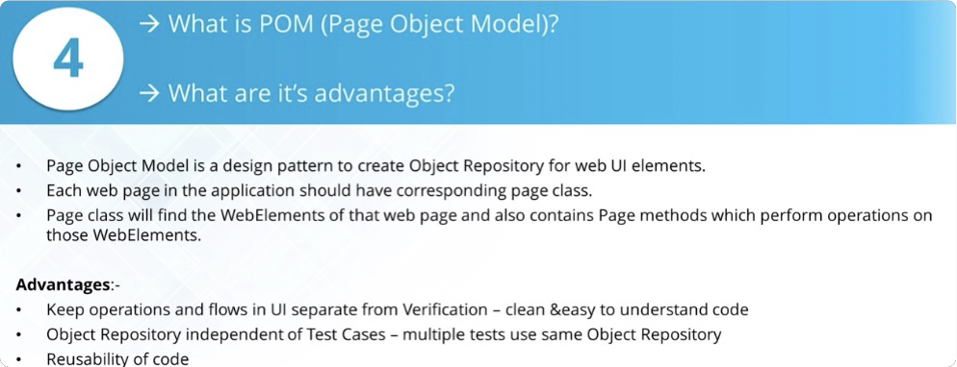
Page Object Model (POM)

Slide 139
Cucumber
Tools used in Behavior driven development. Used for writing tests for web applications. Cucumber works with junit and testng. In my company we use it with junit. Cucumber is good for non technical people, easy reading, saves time, reusability, maintainable, default report, easy to create smoke tests, regression using tags.
In my project we used cucumber for our automation testing. Every sprint I got new stories from jira and write feature file for them. Then I automated those feature files. Using cucumber I can ease run my smoke tests or other tests.

Slide 140
Components of Cucumber BDD framework?
Feature files
Consists of scenarios that test a certain feature or functionality Feature is main story while scenarios are the test cases to the story(feature)
Cukes Runner
A class that strictly runs the tests, generates codes for step definition @smoketest Cukesrunner → IN CUCKESRUNNER I HAVE A FEATURE LOCATION THAT SHOWS WHERE MY FEATURE ARE
LOCATED
Step definition
A class that made of steps that starts with Gherkin
language
Make sure the step definition is in the same package as cukes Runner, or child package (not parent or sibling)

Slide 141
Feature File

Slide 142
Step Definition

Slide 143
Runner Class
I have a runner class that runs my feature files. Using runner class I can generate step defs, run certain tests, configure reports etc.

Slide 144
Report in Cucumber
In my framework I can generate two different html reports. My reports have detailed steps and the screenshot for failures
Default cucumber html reports. —> this is a default reporter meaning I do not need to do anything in the pom file to get this.
We get this report every time when we run the cukesrunner. It does not depend on terminal or maven. Even if I run it by right clicking the cukes runner or clicking on that green thingie, we still get the report.
maven-cucumber-reporting —> this is a plugin in pom file. I have to add this plugin info to my pom file to make it work. We also need to add json option in the cukes runner. This report shows more metrics, pass, fail rates, enables sorting by tags.
To generate this plugin we always have to run using terminal / maven

Slide 145
How to see your reports in cucumber?
Our Cucumber BDD framework generates HTML reports.
The report shows the pass/fail coverage for feature files, tags, steps
The report contains all the steps for each test The report has screenshots for failures
My framework generates cucumber­reports folder in the target folder which contains the reports. When we run the tests on Jenkins, Jenkins saves the report of every run. Home page of the Jenkins job always points to the last run reports. All the reports for previous runs can be found under the build number.
Go to target folder Open with system explorer Go to target>cucumber­report>index ­ shows the tests you ran

Slide 146
dryRun in Cucumber
dryRun is used when we want to generate step definitions without actually running tests.

Slide 147
Hooks in Cucumber
They are methods that run before or after every scenarios. In cucumber we have @before and @after tags used for hooks. We used for general actions like open browser, set up connection, generate reports, quit browser. Hooks is a cucumber thing, it does not come from junit or testing
Cucumber hook allows us to better manage the
code workflow and helps us to reduce the code redundancy. We can say
that it is an unseen step, which allows us to perform our scenarios or tests. Class that uses
○ @Before → runs before each cucumber scenario
○ @After → runs after each scenario (It will always run no matter if scenario passes or fails) Class must be in same package as stepdefinition I implemented screenshots insidehook class HookClass will not run if dryRun=true
I use Scenario as a parameter in my before/after method

Slide 148
Re-run Failed Tests in Cucumber
We have to report all the failed tests using rerun option. When we run tests, all the failed scenarios will be reported in rerun.txt file.
I create another runner will only runs tests listed in the rerun.txt file.
I add both of the runners in the pom file and run tests using maven from terminal. Then my pom file runs the main cukes runner first after that it runs the failed test runner second.
we use the re-run option in the CukesRunner.
Add the rerun to cukes runner.
This option will create a file with a list of failed tests
Create a second runner class which points to file with a list of failed tests
Add the second runner in the pom file

Slide 149
How do you take screenshots in cucumber
- IN my framework i have the logic for taking screen screenshots in the hook class. that is because i want to take screenshot even if the test fails. Hook guarantees that the method for screenshot will work even if test fails.
- TakeScreenshot interface is the method used to take the screenshot. It comes from selenium interface.
- this report is the same report used in my jenkins test. when on jenkins i generate the report using the cucumber reports plugin
- when i run locally same report is generated by the configuration in the pom file.
- both of this configuration options use the Json file to generate report
PLUGIN = "json...."
In my Aftermethod i use a code: I use TakeScreenShot interface You can store screenshot as a byte or file
@After public void tearDown(Scenario scenario) { if(scenario.isFailed()) { //taking a screenshot
final byte[] screenshot = ((TakesScreenshot) Driver.getDriver()).getScreenshotAs(OutputType. BYTES); //adding the screenshot to the report scenario.embed(screenshot, 'image/png'); }

Slide 150
Maven

Slide 151
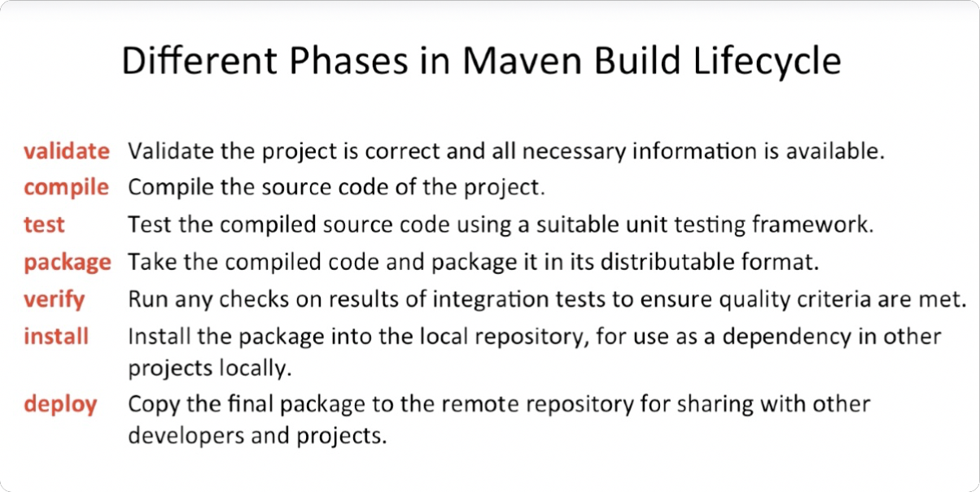
Maven Lifecycle

Slide 152
POM.xml File
A file that manages the whole project
When you run a maven command, everything should be done through the pom.xml

Slide 153
Abstract Class in your framework
These concepts are commonly used in framework development. Abstract class is used in defining a common super class while writing Page Object Model layer of the framework. We usually create an abstract class named BasePage to have all common members for every page written in this class e.g getPageTitle().
Then each Page class (HomePage, LoginPage, DashboardPage etc.) inherit from BasePage. Sometimes one may need to change the behavior of methods implemented in superclass. So subclass has freedom to override that method where we use polymorphism. This is how we use Abstract class in real projects.

Slide 154
Maps in your framework
I used Maps to capture data from Feature file in Cucumber/
Then Users list should be as following
|1234|IT_Prog| |1232|IT_Prog| |1934|IT_Prog|

Slide 155
POJO

Slide 156
Scenario Outline vs Scenario?
Scenario in cucumber runs once. Used for data driven testing Have the same cucumber steps but we provide data after the scenario as a table using keyword examples

Slide 157
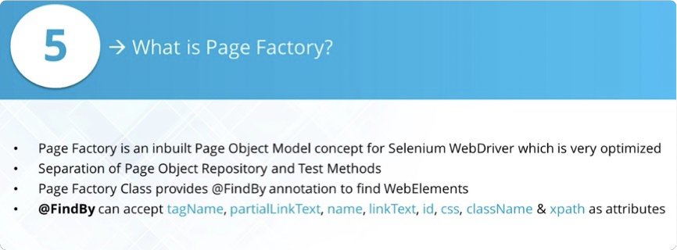
Page Factory?
Page factory is a class that is used to initialize the page object classes.
Without using the PageFactory.initElements, page object class with not work as expected, for example @FindBy will not work.
PageFactory.initElements(Driver.getDriver(), this);

Slide 158
Utilities

Slide 159
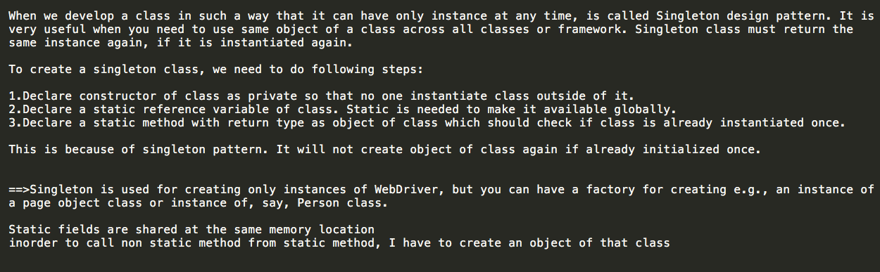
Singleton in Framework

Slide 160
TestNG vs JUnit

Slide 161
TestBase Class ?
● Test Base class is class where I have most used methods in my tests.
● My test classes extend the Test Base class and thus have access to those methods. This helps me us make my
code reusable
● Before/after test methods wait/synchronization utility methods.
○ SwitchToWindow(title)
○ WebDriver driver;

Slide 162
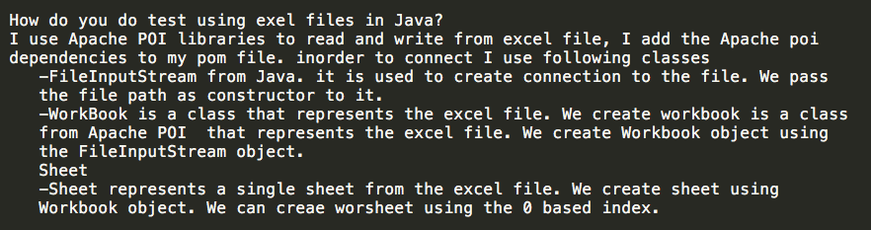
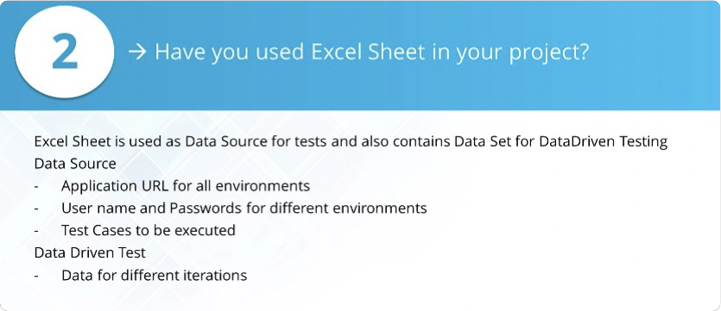
Excel in Framework

Slide 163
BackEnd Testing

Slide 164
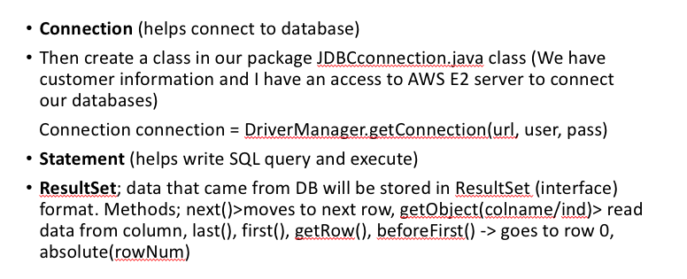
JDBC

Slide 165
What is API
It means connectivity. I mean API is the messenger that takes requests and tells a system what you want to do and then returns the response back to you.
API is the acronym for Application Programming Interface (which is software intermediary) that allows how applications to talk to each other.
API (communication point, middle man) – is an application without UI
If API communication happens through internet, we call it Web Services like Selenium API for browser, JDBC API for Database
If communication happens through systems à REST API
Types
SOAP (Simple Object Access Protocol) –XML format for request & response, it is platform independent (doesn’t care the programming languages)
REST (Representational State Transfer) (RestFul API) – more popular, XML or JSON file Postman, Rest Assured Library for Java -> <- Oracle ORDS – REST API

Slide 166
RESTFul
REST stands for Representational State Transfer ● RESTful is referred for web services written by applying REST architectural concept.
○ In RESTful, web service http methods like GET, POST, PUT, DELETE can be used to perform CRUD operations.
○ CRUD = Createa-Reada-Updatea-Delete

Slide 167
How do you test Rest API?
I verify if each REST API endpoint is working as expected.
I use POSTMAN for manual API testing and use RESTASSURED library in Java for automation.
I send POST,PUT,GET, DETELE type of requests and verify response status code and response body, header.
I also do positive and negative testing of API.
When I do positive testing, I send valid request parameters , valid headers, valid request json body and verify that response status code is
200 successful and Json response body data is also matching the expected.
When I do negative testing, I send invalid request parameters , or invalid headers, or invalid request json body and verify that response
status code is not 200 and Json response body contains error message.

Slide 168
HTTP methods in REST (CRUD)
Create → POST (send data to the server)
Read → GET (retrieves data from given server using a given URI)
Update → PUT (Replaces all current representations of the target resource with the uploaded content)
Delete → DELETE (Removes all current representations of the target resource given by a URI.)

Slide 169
Authentication vs Authorization
authentication --> who are you authorization --> what rights do you have Authentication is user and password Authorization has types:
○ no Authorization
○ Basic Authorization
○ Bearer Token
○ Inherit Auth from parent

Slide 170
Serialization vs DeSerialization
Serialization; when we MAP a Java object to API JSON format (CONVERT JAVA OBJECT TO JSON);
○ Java object (POJO(Plain Old Java Object), BEANS) → MAP it to API JSON/XML
○ When we have an object from a class and MAP it to a JSON format in our RESTful API
Deserialization; API JSON/XML → MAP it to Java Object (JSON TO JAVA OBJECT)

Slide 171
Verify from back-end

Slide 172
Validate JSON Response

Slide 173
Status Codes in API
1xx → Informational
2xx → Success (request was accepted successfully)
(200→ Ok, 201→ Created, 202→ Accepted, 204→ No Content)
3xx → Redirection
4xx → Client Error
(400-Bad Request, 401-Unauthorized, 403-Forbidden, 404-Not Found, 405-Method not Allowed)
5xx → Server Error
(500-Internal server Error, 502-Bad Gateway, 501-Not implemented, 503-Service Unavailable)

Slide 174
POST vs PUT

Slide 175
Swagger
Swagger is a tool for API documentation, it gives description of API endpoints and how to use them.
Swagger is an open-source software framework backed by a large ecosystem of tools that helps developers design, build, document, and consume RESTful Web services.
Swagger allows you to describe the structure of your APIs so that machines can read them.
The ability of APIs to describe their own structure is the root of all awesomeness in Swagger
similar to xml schema but for Json

Slide 176
Do you have API documentation website for your API?
Yes, we use swagger for our api documentation, and this is where the description and guidelines of API endpoints are

Slide 177
Endpoint

Slide 178
Parameters (Path vs Query)
TYPES:
PATH PARAMETER (VALUE WILL BE PART OF URL)
QUERY/REQUEST PARAMETERS (KEY+ VALUE FORMAT)

Slide 179
XML
In computing, Extensible Markup Language (XML) is a markup language that defines a set of rules for encoding documents
in a format that is both human­readable and machine­readable.

Slide 180
JSON
It is JavaScript Object Notation (is a minimal, readable format for structuring data.)
It is used primarily to transmit data between a server and web application, as an alternative to XML.
Basically, a lightweight version of XML
In Key: Value format
Key is always in double quotes and value if string its double quotes and if numbers no quotes
It is purely based on http protocol, - so it hits the link on the browser and see the results

Slide 181
SOAP vs RESTful
RESTful supports JSON, XML, TEXT, however SOAP supports only XML
REST is faster than SOAP based web services

Slide 182
REST vs SOAP

Slide 183
query parameters and path parameters?

Slide 184
How do you read JSON data in Java?

Slide 185
End to End Testing Scenarios: UI, API, DB
End to End Testing -> Involving Functionality End to End Testing -> Involving Functionality Plus Each Layer Of Application
1) Go to UI -> Add An Employee 1) Go to DB and verify if employee is added and all data is matching 2) API -> GET request and verify if employee is added successfully and all data is matching
-> makes changes in front end and verify in database and REST API.
2) Go to UI -> add an employee:
check in UI search page.
3) POST an employee using REST API:
1) send a GET request with API and verify 2) Go to DB and verify if employee is added successfully and all data is matching 3) Go to front end(website) and verify that data posted is displayed
-> makes changes using REST API then verify in DB and UI
4) INSERT an employee into database:
1) run select statement in DB and verify what you inserted is there in tables
2) send API GET request and verify JSON is matching data you inserted to DB
3) Go to front end(website) and verify that data inserted to DB is displayed
-> make changes in DB using SQL and verify in REST API & front end

Slide 186
OOP

Slide 187
Object vs Class?
Class is a template/blueprint, where we define states which are variables and behaviors which are methods.
Object is a member or instance of the class
Class is declared using class keyword, Object is created through new keyword mainly.

Slide 188
OOP principles?
OOP is a programming language model organized around object rather than actions;
-It makes development and maintenance easier
-It provides data hiding
-It provides ability to simulate real world.
OOP language follow 4 principles:
Encapsulation: is hiding direct access to data by using private access modifier and accessing this
data by using getter and setter methods.
Inheritance: is defining the relationship between two classes. When a child class acquires all properties and behaviors of parent class, solution comes with inheritance. Child class can reuse all the codes written in parent class by overriding. It provides the code reusability and simplicity.
Abstraction : It is a process of hiding implementation details of abstract methods and showing only functionality to the user. Abstraction allows you to focus on what the object does instead of how it does.
Polymorphism: It is an ability of object to behave in multiple form. The most common use of polymorphism in Java, when a parent class reference type of variable is used to refer to a child class object. For example: WebDriver driver = new ChromeDriver();
We use method overloading and overriding to achieve Polymorphism.

Slide 189
Encapsulation and how did use it?
Data hiding by making variables private and providing public getter and setter methods. In my project I created multiple POJO/BEAN classes in order to manage test data and actual data. EXP: I take JSON from API response and convert to object of my POJO class all variables are private with getters and setter.

Slide 190
Abstraction?
In OOP, abstraction is a process of hiding the implementation details from the user, only the functionality will be provided to the user.
In other words, the user will have the information on what the object does instead of how it does it.
In Java, abstraction is achieved using Abstract classes and interfaces.
For example: when you login to your bank account online, you enter your user id and password and press the login. What happens then, how the input data sent to the server, how it gets verified are all abstracted away from you.

Slide 191
Encapsulation vs Abstraction
Abstraction lets you focus on what the object does instead of how it does it.
Encapsulation means hiding the internal details of how the object does something.
Abstraction is used for hiding the unwanted data and giving relevant data.
Encapsulation means hiding the code and data, and to protect the data from outside.
Abstraction can achieved by using Abstract class and Interfaces.
Encapsulation can achieved by using “private” keyword.

Slide 192
Inheritance
Inheritance represents the IS-A relationship which is also known as a parent-child relationship.
It is the mechanism in java by which one class is allowed to inherit the visible features (data fields and methods) of another class.
The idea behind inheritance in Java is that you can create new classes that are built upon existing classes.
When you inherit from an existing class, you can reuse methods and fields of the parent class.
Moreover, you can add new methods and fields in your current class also.

Slide 193
Polymorphism
Polymorphism is a very important concept in OOP because;
it enables to change the behavior of the applications in the run time based on the object on which the invocation happens.
by Polymorphism; one object can have different forms.
Polymorphism is implemented using the concept of Method overloading and method overriding. This can only happen when the classes are under the parent and child relationship using inheritance.

Slide 194
Polymorphism vs Inheritance
Like in real world, Inheritance is used to define the relationship between two classes.
It is similar to Father-Son relationship. In Java, we have Parent class (also known as super class) and child class (also known as subclass).
Similar to the real world, Child inherits Parents qualities, methods and codes. A child class can reuse all the codes written in Parent class and only write code for behavior which is different than the Parent.
Inheritance is actually meant for code reuse.
On the other hand, Polymorphism is an ability of object to behave in multiple form.
It is classified as overloading and overriding.
By the way, they are actually related to each other, because its inheritance which makes Polymorphism possible, without any relationship between two class. It is not possible to write polymorphic code.

Slide 195
Abstract Class?
A class which has the abstract keyword in its declaration is called abstract class.
Abstract classes should have at least one abstract method. i.e., methods without a body.
It can have multiple concrete methods.
Abstract classes allow you to create blueprints for concrete classes. But the inheriting class should implement the abstract method.
Abstract classes cannot be instantiated.

Slide 196
Interface?
An interface in java is a blueprint of a class. It has static constants and abstract methods.
The interface in Java is a mechanism to achieve abstraction.
There can be only abstract methods in the Java interface, not method body.
It is used to achieve abstraction and multiple inheritance in Java.
In other words, you can say that interfaces can have abstract methods and variables. It cannot have a method body.

Slide 197
Abstract Class vs Interface?
A class that is declared with abstract keyword, is known as abstract class. It can have abstract and non abstract methods.
An Interface is a blueprint of a class. It is a template and it is declared with interface keyword. It can have abstract methods, default methods, static methods and public final static variables
When we want to use Abstract class, we use “extend” keyword.
When we want to use Interface, we use “implement” keyword.
Abstract class and interface both are used to achieve abstraction.
Both cannot be instantiated, we cannot create an object.

Slide 198
Abstract class in your project
These concepts are commonly used in framework development.
Abstract class is used in defining a common super class while writing Page Object Model layer of the framework.
We usually create an abstract class named BasePage to have all common members for every page written in this class e.g getPageTitle().
Then each Page class (HomePage, LoginPage, DashboardPage etc.) inherit from BasePage.
Sometimes one may need to change the behavior of methods implemented in superclass.So subclass has freedom to override that method where we use polymorphism.
This is how we use Abstract class in real projects.

Slide 199
Java does not support multiple inheritance?
To reduce the complexity and simplify the language, multiple inheritance is not supported in java.
Java does not support "multiple inheritance" (a class can only inherit from one superclass).
However, it can be achieved with interfaces, because the class can implement multiple interfaces.

Slide 200
“IS-A” vs “HAS- A” relationship?
Is-A Relationship in Java : In Java, an Is-A relationship depends on inheritance. Further inheritance is of two types, class inheritance and interface inheritance. It is used for code reusability in Java. For example, a Potato is a vegetable, a bus is a vehicle.
Has-A Relationship in Java: In Java, a Has-A relationship is also known as composition. It is also used for code reusability in Java. In Java, a Has-A relationship simply means that an instance of one class has a reference to an instance of another class or an other instance of the same class. For example, a car has an engine, a dog has a tail and so on.

Slide 201
overloading vs overriding
First and most important difference between overloading and overriding is that,
in case of overloading, method name must be the same but the parameters must be different; in case of overriding, method name and parameters must be same.
Second major difference between method overloading and overriding is that;
We can overload method in the same class but method overriding occurs in two classes that have inheritance relationship.
We can not override static, final and private method in Java but we can overload static, final and private method in Java.
In method overloading, return type can be same or different. In method overriding, return type must be same or covariant type.

Slide 202
static binding vs dynamic/runtime binding
Static binding is overloading
Dynamic binding is method overriding

Slide 203
Testing

Slide 204
Software Testing?
Process of executing a program or application with the intent of find software bugs using functional and automation tools
Process of validating/verifying a software program/application

Slide 205
Why we test?
To build bug free application.
To satisfied end user and client.
To build great product to generate more revenue.

Slide 206
Is 100% testing possible?
We can’t test the application 100% since there are unlimited scenarios that we can’t even imagine.
Software testing is risk based activity based on priority of the functionality we can test as much as much as possible.
Even though 100% testing is not possible but I believe 100% customer satisfaction is certainly possible.

Slide 207
Test Plan?
Test plan is a word document that described the testing scope
-High level test cycle
-Defect life cycle
-Entrance Criteria (defines what all need to start the testing)
-Exit Criteria (defines what the testing is finished)
If you don’t know where to start and where to finish then your goals are not clear.

Slide 208
Test Case?
Test case describes the functionality and test steps. -Test Case ID -Step number -Description of the functionality -Expected result -Actual Result

Slide 209
When the testing starts?
Testing starts from testing the requirements (not after the coding phase which seems like the most likely answer.)
We have to make sure the requirement is correct in first place.
With the wrong requirement it is impossible to build bug free application.

Slide 210
Defect Life Cycle?
New
Assigned
Open
Fixed
Retested
Close

Slide 211
Epic, User stories & Tasks?
User Stories:User Stories defines the actual business requirement. Generally created by Business owner
Task: To accomplish the business requirements development team create tasks
Epic: A group of related user stories is called an Epic

Slide 212
What is testing hierarchy?
Unit testing – Developers test each module or block of code during development.
Component Testing – Component is a standalone functionality that can work by itself. Ex. Amazon Buyer Functionality, Seller Functionality, Prime Video Functionality.
Integration Testing – Combine all of the Functionalities. When I integrate them, can I still use all of the functions? Make sure they all still work.
System Testing – End­to­End testing. Test everything from beginning to end.
Acceptance Testing – Hire a UAT (User Acceptance Testing) Team or Business Analyst can also do Acceptance Testing. After testing has been complete you have to get another team to do acceptance testing so they can confirm the QA teams testing was successful and have the product ready for the customer.

Slide 213
Requirement Traceability Matrix (RTM)
RTM is used to make sure that all test cases cover the requirement or not. It is like excel sheet.

Slide 214
Defect
When expected result does not match actual result it is a defect.

Slide 215
What to do when you find a defect?
If I find a defect, before report it I re-produce the bug that I need to make sure that is a valid defect.
If it is a small issue, I will go to the developer desk, and he can fix it right away.
If it is a big issue, then I open my JIRA and log the defect.
If I am not sure it is bug or not I will talk to SME (subject matter expert it means the person who knows the application better than anyone).

Slide 216
If Developer says not a defect, what to do?
I always make sure that it is a real defect that’s why I reproduce it.
I take a screenshots and give all the steps to reproduce the defect
Actually one of my biggest challenges that I faced in my current project is that…

Slide 217
When will you Automate?
If it is taking a lot of manual effort. I run at least once manually and after that I automate it. Automation is good for most repetitive functionality. -If the test cases are high priority test cases. -If the functionality is critical functionality. -Shakeout or smoke-test test cases. -If the test cases are too long and too difficult to execute. The regression test cases based on the priority. -We should automate as much as possible.

Slide 218
When will you not Automate?
-If functionality keeps changing -If functionality is used only once during the entire project -Ad-Hoc test can not be automated.

Slide 219
Debugging vs testing?
The main difference between debugging and testing is that debugging is typically conducted by a developer who also fixes errors during the debugging phase. Testing on the other hand, finds errors rather than fixes them. When a tester finds a bug, they usually report it so that a developer can fix it.

Slide 220
Peer review?
Peer reviews are reviews conducted among people that work on the same team. For example, a test case that was written by one QA engineer may be reviewed by a developer and/or another QA engineer.

Slide 221
Who writes test plans and test cases?
Test plans are typically written by the quality assurance lead while testers usually write test cases.

Slide 222
Bug severity vs bug priority
Bug severity refers to the level of impact that the bug has on the application or system while bug priority refers to the level of urgency in the need for a fix.
Usually the severity is defined in terms of financial loss, damage to environment, company's reputation and loss of life.
Priority of a defect is related to how quickly a bug should be fixed and deployed to live servers.

Slide 223
System testing and integration testing?
For system testing, the entire system as a whole is checked,
whereas for integration testing, the interaction between the individual modules are tested.

Slide 224
Black box vs white box testing?
White Box Testing has many names such as Glass Box, Clear Box, or Structural Testing. It requires the testers to gain code-level perspective, design cases to exploit code and find potential bugs.
Black Box Testing is a standard software testing approach which requires testers to assess the functionality of the software as per the business requirements. They treat the software as a black box and validate as per the end user point of view. It applies to all levels of software testing such as Unit, Integration, System or Acceptance Testing.

Slide 225
Front End Testing and Back End testing?
Front End Testing is performed on the Graphical User Interface (GUI), whereas Back End Testing involves databases testing. Front end consist of web site look where user can interact whereas in case of back end it is the database which is required to store the data.
When user enters data in GUI of the front end application, then this entered data is stored in the database. To save this data into the database we write SQL queries.

Slide 226
Functional testing & non-functional testing
Functional testing is a type of testing which verifies that each function of the software application operates in conformance with the
requirement specification.
-Unit Testing
-System Testing
-Smoke Testing
-User Acceptance Testing
-Integration Testing
-Regression Testing
Non-functional testing is a type of testing to check non-functional aspects (performance, usability, reliability, etc.) of a software application.
-Performance Testing
-Stress Testing
-Load Testing
-Security Testing

Slide 227
Java Technical

Slide 228
Even - Odd
if(num % 2 == 0) System.out.println(num + " is even");
else
System.out.println(num + " is odd");

Slide 229
Swap Numbers
x = x + y; y = x - y; x = x - y;

Slide 230
Reverse String
public static String reverseString (String str) {
String reverse= "";
for(int i = str.length()-1; i >=0; i--) {
reverse += str.charAt(i); }
return reverse; }

Slide 231
Reverse Integer
int num = 1234, reversed = 0; while(num != 0) { int digit = num % 10; reversed = reversed * 10 + digit; num /= 10; } System.out.println("Reversed Number: " + reversed); }}

Slide 232
Prime Numbers
public static boolean isPrime (int number) {
for(int i=2; i < number ; i++) { if(number%i == 0) { return false; }} return true; }

Slide 233
String Palindrome
for(int i=word.length()-1;i>=0;i--) {
reverse+=word.charAt(i); }
if(word.equalsIgnoreCase(reverse)) {
System.out.println("The word is palindrome"); }else {
System.out.println("The word is not palindrome”); }

Slide 234
Integer Palindrome
public static boolean isPalindrome(int number) {
int palindrome = number; int reverse=0; while (palindrome! = 0) { int remainder=palindrome%10; reverse = reverse*10 + remainder; palindrome = palindrome/10; if (number == reverse) { return true; } return false;
} }}

Slide 235
Factorial
int number = 10; int factorialSum = 1; for(int i = 1 ; i <=number; i++) { factorialSum = factorialSum * i; }
System.out.println("Factorial of " + number + " is " + factorialSum); }

Slide 236
Sum of Digits
int number = 1346; int sum = 0; while(number > 0) { sum += number%10; number = number/10; } System.out.println(sum); }

Slide 237
Fibonacci
public static void main(String[] args) { int previousNumber=0; int nextNumber=1; int maxNumber=0;
Scanner scan=new Scanner(System.in);
System.out.println("How many numbers you want in Fibonacci?"); maxNumber=scan.nextInt(); System.out.println("First"+maxNumber+" Fibonacci numbers"); for(int i=0;i<=maxNumber;i++) { System.out.print(previousNumber+" "); int sum=previousNumber + nextNumber; previousNumber = nextNumber; nextNumber=sum; }}}

Slide 238
FizzBuzz
public static void main(String[] args) {
for(int i = 1 ; i<=50 ; i++) { if ( i % (5*3) == 0 ) {
System.out.println("FizzBuzz");
} else if(i%3==0){
System.out.println("Fizz"); }else if(i%5==0) { System.out.println("Buzz");
}else {
System.out.println(i); }}}}

Slide 239
Only Unique Letters
public static String uniqueChars(String str) {
String unique = ""; for (int i = 0; i < str.length(); i++) { if (!unique.contains("" + str.charAt(i))) {
unique += str.charAt(i); }} return unique; }}

Slide 240
Remove Duplicates
converting theArrayList to a HashSet effectively removes duplicates
Set<String> s = new LinkedHashSet<>(list);

Slide 241
Largest Number in Array
int [] arr = {5, 6, 76, 31, 43, 1};
Arrays.sort(arr);
System.out.println (arr[ arr.length - 1 ]);

Slide 242
Armstrong Number
public static void main(String[] args) { Scanner scan=new Scanner(System.in); System.out.println("Please enter number"); int number=scan.nextInt(); System.out.println("Please enter number of digits");
int digit=scan.nextInt(); int temp=number; int sum=0; do {
int value = temp % 10; temp /= 10; sum += Math.pow (value , digit); } while (temp>0); if (number==sum) { System.out.println("This is an Armstrong number"); }else { System.out.println("This is not an Armstrong
number”); }}}

Slide 243
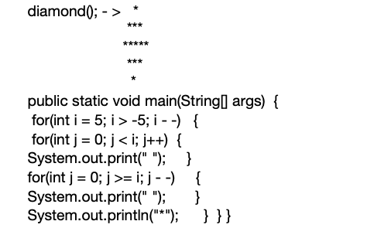
Diamond of Asterisks

Slide 244
Pyramid Of Numbers
Scanner scan=new Scanner (System.in);
System.out.println("How many rows you want in your pyramid?"); int noOfRows=scan.nextInt(); int rowCount=1; System.out.println("Here is your pyramid"); for(int i=noOfRows;i>0;i--) { for(int j=1;j<=i;j++) { System.out.print(" “); } for(int j=1;j<=rowCount;j++) { System.out.print(rowCount+ " “); } System.out.println(); rowCount++; }}}

Slide 245
Floyds Triangle
Floyd’s triangle is the right angled triangle consists of natural numbers in the following fashion. Floyd's Triangle :
1 23 456 7 8 9 10 11 12 13 14 15
public static void main(String[] args) {
System.out.println("How many rows you want in Floyd's Triangle?"); Scanner scan = new Scanner(System.in); int noOfRows = scan.nextInt();
int value = 1; System.out.println("Floyd's Triangle : "); for(int i=1 ; i<=noOfRows ; i++) { for(int j=1 ; j<=i ; j++) { System.out.print(value+ " "); value++; } System.out.println(); }}}

Slide 246
Anagram
What Is Anagram? Two strings are called anagrams if they contain same set of characters but in different order. For example, “Dormitory – Dirty Room”, “keep – peek”, “School Master – The Classroom” are some anagrams.
static void isAnagram(String s1, String s2) { // Removing all white spaces from s1 and s2 String copyOfs1 = s1.replaceAll("\\s",""); String copyOfs2 = s2.replaceAll("\\s",""); boolean status = true; if (copyOfs1.length()! = copyOfs2.length() ) { status=false; }else { char[]s1Array=copyOfs1.toLowerCase().toCharAr ray(); char[]s2Array=copyOfs2.toLowerCase().toCharAr ray(); Arrays.sort(s1Array); Arrays.sort(s2Array); status= Arrays.equals(s1Array, s2Array); } if(status) { System.out.println(s1+ " and "+ s2+ " are anagrams"); }else { System.out.println(s1+ " and "+ s2+ " are not anagrams”); }}

Slide 247
SDLC-Agile

Slide 248
SDLC and what is it used for?
SDLC is an abbreviation of Software Development Life Cycle. SDLC defines the phases in building of software or application.
• Project Planning • Requirement Gathering (Gathering information
used to plan project, Identifying risks)
• Design (How the application will be built)
•Coding (developing) (Based on requirements, developers will write the application)
• Testing
• Production (deployment)(Releasing product)
•Maintenance (Making sure product is stable, looking at customer report on bugs and fixing it)

Slide 249
Software Testing Life Cycle (STLC)
STLC defines the phases in testing of software or application. In STLC process in different activities are carried out to improve the quality of the product.
• Requirements analysis • Test Planning • Test Designing • Test Environment Setup • Test Execution
• Test Reporting

Slide 250
STLC vs SDLC
STLC is part of SDLC. It can be said that STLC is a subset of the SDLC set. The complete Verification and Validation of software is done in SDLC, while STLC only does Validation of the system.

Slide 251
Validation and verification ?
Validation is the process, whether we are building the right product
Verification is the process, to ensure that whether we are building the product right

Slide 252
Requirement document?
Requirements convey the expectation of users for the software or product. In other words, all the expected functionalities out of the application are documented in terms of “Requirements” and this document is called a Requirement document. It is also called an SRS document, which stands for System Requirement Specification Document. The SRS documented is prepared by the Business Analyst by taking all the requirements for the customer.

Slide 253
Where is the requirement coming from?
Customers give requirements for the application Talk to the End-users the person that will be using this application the most
Talk to Partners
Talk to Domain Experts – coders and developers that have already build this application similar before or someone that is an expert the type of product being built
Industry Analysts and Information about competitors

Slide 254
The requirement is good or bad?
Requirement must be (SMART) Specific User should be able to login. Authorized
user with valid username and password should be able to login Measurable User should able to login very fast (in 2 second after clicking login button).
Attainable Realistic Testable

Slide 255
Agile
Agile is flexible methodology using for Software Development.
You can go back.
It keeps on changing.
Changing is always welcome.

Slide 256
Agile Framework?
Role : PO, SM, Team
Ceremonies : Sprint Planning, Daily Scrum, Sprint Review, Sprint Retro, Grooming Session
Artifacts : Product backlog, Sprint backlog, Burnout chart

Slide 257
Waterfall?
Waterfall methodology is the sequential method using for Software Development.
You can not go back and have to finish the phase before you move on.

Slide 258
Agile methodology did you use in your previous projects ?
I have heard Extreme programming(XP) , Kanban and Scrum.
But I have only worked with scrum only.

Slide 259
Relation between Agile and Scrum? What is Scrum?
Agile is the software development methodology that focuses on customer satisfaction by delivery shippable software frequently.
Scrum is one of the many approaches to implement Agile.
Scrum is an Agile framework.
Scrum is suitable for certain type of projects where there are rapidly changing requirements.
In simple words, Agile is the practice and scrum is the process to following this practice.

Slide 260
Why do we need Agile? Waterfall and Agile?
Because waterfall methodologies have following disadvantage; Requirement can not be change or hard to change once document is signed.
In waterfall before completing the one phase you can’t move to the next phase. For example, before coding phase is completed testing can not be started.
Customer can’t see what they are going to get until very late stage in development life cycle. It takes longer time to go to the production. By the time product goes to the market it might be outdated already.
Agile has following advantages: The change is welcomed. For example after the sprint demo if client does not like something we can take their feedback and improve the product. Requirement change is OK. Since it is iterative development process, the development team can developed piece of functionality, get feedback and improve next iteration. So the product will be continuously improve.

Slide 261
Different roles in Scrum?
Product owner is actually the stakeholder of the project. He represents the project requirements before the team.He is responsible to have a vision of what to build and convey his detailed vision to the team. He is the starting point of an agile scrum software development project.
Scrum team is formed by the collective contribution of individuals who perform for the accomplishment of a particular project. The team is bound to work for the timely delivery of the requested product.
Scrum master – Scrum master is the leader and the coach for the scrum team who checks whether the scrum team is executing committed tasks properly. He is also responsible to increase the efficiency and productivity of the team so that they can achieve the sprint goal effectively.

Slide 262
Describe a scrum team?
For me the team is a group of people who are sharing the same goal , moving to the same direction , who trust each other and who will effectively communicate and collaborate with each other to build great product. There should be no star individual but a star team.

Slide 263
Scrum of scrums?
In case, there are multiple teams involved in the project, scrum of scrums is used to scale the daily stand-up meeting.
It supports agile teams to collaborate and coordinate their work with other teams.

Slide 264
Burn-down and burn-up charts
To track the progress of an ongoing project, these charts are used.
Burn-up charts indicate the work that has been completed while
Burn-down chart shows the amount of remaining work in a project.

Slide 265
Sprint?
In Scrum, the project is divided into Sprints.
Each Sprint has a specified timeline (2 weeks to 1 month). This timeline will be agreed by a Scrum Team during the Sprint Planning Meeting. Here, User Stories are split into different modules. The end result of every Sprint should be a potentially shippable product.

Slide 266
Product backlog & Sprint Backlog?
Product backlog is maintained by the project owner which contains every feature and requirement of the product.
Sprint backlog can be treated as subset of product backlog which contains features and requirements related to that particular sprint only.

Slide 267
Velocity of a sprint and how it is measured?
Velocity is one of the planning tool used to estimate the speed of the work and time of completion of the project.
The calculation of velocity is done by reviewing the work team has successfully completed during earlier sprints;
for example, if the team completed 5 stories during a two-week sprint and each story was worth 3 story points, then the team's velocity is 15 story points per sprint.

Slide 268
Behavioral

Slide 269
Biggest Accomplishment?
I would say is establishing a great trustworthy relationship within the team. If you are asking for technical: When I joined my last project, the application had very less “id” so I had to spend hours to locate one WebPage elements in my POM project so I communicated with developers and other team members and all together we come up with the solution which I got the access to put id in the application by myself. That was great for me it saved my and others time. So instead of spending time to locating elements I spend my time to more creating automation test scripts and executing them.

Slide 270
Why did you apply for this position?
After looking at the job description, I think it matches my day-to-day activity and my experience.
I was confident with the job description that’s why I applied.
Also, I have done some research on the company and I am really excited about the company’s product and services like...

Slide 271
Where do you see yourself 5 years from now?
I want to learn as much as possible to be more technical. I would like to see myself SDET. I want to be technically very competitive person 5 years from now.

Slide 272
Why should we hire you?
I think you should hire the candidate that has the best qualifications for this position. Since I don’t know the other candidates, I can represent only myself. I think my experience and technical expertise will bring a lot of values and benefits to the company and the project. I think that’s why you should hire me.

Slide 273

Weakness?
Well, I think my weakness is that whenever I am given some responsibilities and there is a deadline for it, I work day and night, sometimes 7 days a week. This is bad for my family life, the reality is I can not sleep unless I am done with my assignments.

Slide 274
Strength?
Well, I am very detail oriented person. I have the sense of urgency. I can prioritize my job according to the deadline. I am very much dedicated towards my job. I am honest. I have the skills and expertise in QA process. These are some of my strengths.

Slide 275
challenge you faced during your last project?
I think, one of the biggest challenges that I faced with in my current project is that…
… everytime I found a bug, the developer disagreed to accept it and most of the time we had to ask BA for clarification. Then I realize the requirement itself was not specific enough, so I understood it differently than the developer. In the Sprint Retro, I said we should spend more time on requirement clarification because you know that is the key to the project success. We did so and this issue was solved. Work on result more. I think, the most important problem is misunderstanding and the lack of communication in the business life. If we come together as a group and discuss it, there is nothing we cannot solve. I'm really grateful and blessed to have been in the team that I was in, because we were able to collaborate and come together to solve the problem.
The challenge I have faced is locating dynamic elements by retrieving the right HTML code. One of my recent challenge is that another coworker who is also QA had to leave.

Slide 276
How do you handle stress? Or Conflict?
Nothing is personal. Everyone thinks company’s benefits so I would like to explain my concern and his/her explanation makes sense for me. Of course, I can do the things which is most helpful to my company. So, I try to communicate with his/her and I would try to understand the concern. Because everyone have the same goal and wants to get job done successfully.Aıso in scrum environment we working as a team . I always maintain good communication and relationship with my colleagues. So they trust me and they can communicate with me very easily. . . I always avoid miscommunication and my team believe me every time.

Slide 277
Can you start tomorrow?
My team won’t be happy with me if I leave tomorrow, and I don’t think it is professional and I have never done that before. I have to transfer the automation framework knowledge to other team members before I leave.

Slide 278
What do you do if I hire you?
In first week, you know, I will get done all the paper works, getting the machines and necessary access to the project, databases etc.Then I will have to learn the company culture. I have to learn also more about my projects and my teammates. I think, understanding what the project is doing, it is very important if I want to be more productive.

Slide 279
how long are you planning to stay?
As long as there is a project to work, I am willing to stay as long as possible.

Slide 280
Can you work under pressure?
I don’t remember any project that I worked had no pressure. Pressure is good thing sometimes. It forces you to work harder and smarter.

Slide 281
What do you like the most about testing?
Testing is fun job for me because you are very important person to the client and end users. I love testing because as end user I want to buy better product that is piece of art and defect free. Also, I am helping others to make sure their product has top quality.

Slide 282
What to do in case of you have too much work and you can not finish for the deadline?
When developers don’t deploy their code on time, our tester team don’t have enough time for completion. And the upper management keeps asking for us for completion. - Some of my team members simply focuses on task completion and not on the test coverage and quality of work. - So, at the Sprint Grooming Meeting, I suggested that we should work very closely with the developer and make sure that we are communicating on daily base. And also, the developers prioritize the important tasks and work on them first. Any scenarios left, would be pushed to the next sprint since it is not as important as the other ones. - Lastly, I try to prioritize my work and follow my test lead and manager whatever they see is more important I start with that.

Slide 283
Do you have any question for us?
it's important to me that I continually improve and try to achieve excellence in my position and the best way to do this is to continually learn. I'm always trying to learn new things or learn old things better.
Do you provide trainings, seminars or anything to support the education of your employees?
What are the next steps in the interview process?

Slide 284
Jenkins - Git

Slide 285
Jenkins
Jenkins used to automate the processes related to deployment and delivery.
Jenkins is application that is hosted in some server. My company uses AWS for hosting jenkins. Our Operations (DevOps) team set up the was instance, install Jenkins and other required tools.

Slide 286
Jenkins – How do you create a job?
In my company devops team (operations team) maintains the jenkins and as a tester my jenkins account user do not have enough privilege to create new jobs. I can only see the jobs and results.
To create my smoke tests on jenkins I created a ticket in jira for the devops team.
But also know how to create and configure jenkins jobs myself. I have do in in my previous projects.

Slide 287
Configure Jenkins
as a test engineer I only configured my smoke tests on jenkins. how we configure our smoke test also depends on what tools we have in our framework. I have a cucumber + junit+ maven framework. so this is how that job is configured:
1. Source Code Management
here we specify where to get the code from. we put the link to our repo and also enter the login information
2. Build Triggers
we specify how often we run those tests. we choose Build periodically because we want to run in certain schedule. in my project, we run smoke tests every morning. so in the build trigger we entered daily option:
H 6 * * * --> every day 6 in the morning
3. Build
here we enter the details of the actual run. since my project is based on maven, i choose option: Invoke top-level maven targets then i choose which maven to run from the version dropdown. in the next field, i enter the maven goal: test. in this field we do not need to enter the word mvn. i also mention here which tag i want to run. so the command will be:
test -Dcucumber.options="--tags @smoke"
4. Add Post-build Actions
in the post build actions, we configure what we want to to after the ends. after each test we generate report and email
a. report : we generate report using Cucumber reports plugin. i select Cucumber reports plugin from the Post-build Actions to generate reports.
b. email : using the email plugin we can send email after every build. i select Editable Email Notification option from the Post-build Actions to send emails.

Slide 288
How does Jenkins work overall?

Slide 289
How about pipeline with Jenkins?
I have built smoke tests on jenkins which part of the devops pipeline are. devops pipeline is built and managed by DevOps/Operations Support. But our smoke test are part of the pipeline.
So, I participated by creating and configuring the smoke tests on jenkins.

Slide 290
How many environment do you have?
1. dev enviroments
2. QA/Test enviroment- this is where i test
3. Staging enviroment
4. Production
1.Dev Environments → developer work
2.QA Environments → SDET and manual tester work
3. Stating/ pre-production Environments → regression test
4. Production Environments → real user use

Slide 291
How do you use Git?

Slide 292
Git Commends
Add: add to staging area
Commit: add from working directory and local repo
Push: add to remote repo
Pull: take changes from remote to working directory

Slide 293
Branching Strategy
how do you do git branching now?
Currently HOW IT IS DONE IN GROUP PROJECTS:
There is master branch and separate branches for each team member. when someone finishes work, they push to their own branch, then after reviewing it is merged to master.
HOW WE DID IT?
in my project we had master, develop and branch for person. so, if we have 2 automation testers, we will have master - develop - tester1 - tester2
each tester check in to their own branches. then after reviewing it is merged to develop branch. we merge master and develop only once a sprint.
the interview when they ask about branching, talk about your automation project branching strategy. in you project, your code is separate repo from the application code repo. Automation framework have a smaller code base and fewer people involved. So, we can have less complicated branching policy.

Slide 294
AWS
AWS is providing cloud VM. Create an EC2 instance.
I can use this instance with remote desktop.
Actually after lunch my instance I just use a regular computer.

Slide 295
Will be added

Slide 296
How many test cases automated per day?
It depends on test case scenario complicity, I did automate 2-5 test scenarios per day when the complexity is limited. Sometimes just 1 or fewer test scenarios in a day when the complexity is high.

Slide 297
Reverse String in Java
1:
String string="whatever";
String reverse = newStringBuilder(string).reverse().toString();
System.out.println(reverse);
2:
String result="";
for(int i = string.length()-1; i>=0; i--){
result = result+ string.charAt(i);
}
System.out.println(result);

Slide 298
Overloading vs Overriding
overlaoding
same method name but different parameters
return type can be different
overriding
same type or sub type
same method name and same paramethers

Slide 299
How Selenium Grid works?
Selenium Grid sent the tests to the hub. These tests are redirected to Selenium Webdriver, which launch the browser and run the test. With entire test suite, it allows for running tests in parallel.

Slide 300
IntelliJ
Intellij is an IDE that helps you to write better and faster code for Selenium. Intellij can be used in the option to Java bean and Eclipse.

Slide 301
How to select value in a dropdown?
Value in the drop down can be selected using WebDriver’s Select class.
Syntax:
selectByValue: Select selectByValue = new Select(driver.findElement(By.id(“SelectID_One”))); selectByValue.selectByValue(“greenvalue”);
selectByVisibleText: Select selectByVisibleText = new Select (driver.findElement(By.id(“SelectID_Two”))); selectByVisibleText.selectByVisibleText(“Lime”);
selectByIndex: Select selectByIndex = new Select(driver.findElement(By.id(“SelectID_Three”))); selectByIndex.selectByIndex(2);

Slide 302
verify if the checkbox/radio is checked or not ?
We can use isSelected() method.
driver.findElement(By.xpath("xpath of the checkbox/radio button")).isSelected();
If the return value of this method is true then it is checked else it is not.

Slide 303
perform right click using WebDriver
Use Actions class
Actions act = new Actions(driver); // where driver is WebDriver type
act.moveToElement(webElement).perform();
act.contextClick().perform();

Slide 304
perform drag and drop using WebDriver
Use Action class
Actions act = new Actions(driver);
WebElement source = driver.findElement(By.xpath(“ -----”)); //source ele which you want to drag
WebElement target = driver.findElement(By.xpath(“ -----”)); //target where you want to drop
act.dragAndDrop(source,target).perform();

Slide 305
upload a file?
To upload a file we can use sendKeys() method.
driver.findElement(By.xpath(“input field”)).sendKeys(“path of the file which u want to upload”);

Slide 306
click on a menu item in a drop down menu
If that menu has been created by using select tag then we can use the methods selectByValue() or selectByIndex() or selectByVisibleText(). These are the methods of the Select class.
If the menu has not been created by using the select tag then we can simply find the xpath of that element and click on that to select.

Slide 307
simulate browser back and forward
driver.navigate().back();
driver.navigate().forward();

Slide 308
get the current page URL ?
driver.getCurrentUrl();

Slide 309
check if a button is enabled on the page ?
Use isEnabled() method. The return type of the method is boolean. So if it return true then button is enabled else not enabled.

Slide 310
get the title of the page
Use getTitle() method.
Syntax- driver.getTitle();

Slide 311
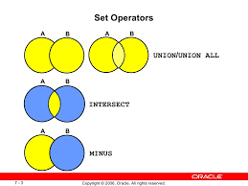
INTERSECT VS MINUS
INTERSECT DISPLAYS COMMON DATA IN BOTH QUERIES. REMOVES DUPLICATES and multiple NULLS , SORTS RESULTS
MINUS DISPLAYS DATA minus returns records from first query that is not present in second query.

Slide 312
JOIN VS UNION?
JOINS are used to query data from multiple tables
UNION is used to query data from multiple queries

Slide 313
GROUP BY VS ORDER BY
GROUP BY is used whenever we work with group functions, it will help to create sub groups within a group
ORDER BY is used to sort the data in either desc or asc order

Slide 314
HAVING VS WHERE
HAVING is used whenever our condition includes a GROUP function HAVING MAX(salary) > 9000;
WHERE is used to filter the results and when we do not use GROUP function
WHERE employee_id = 234;

Slide 315
DROP VS TRUNCATE
BOTH ARE DDL COMMANDS AND CANNOT BE UNDONE
DROP WILL REMOVE DATA AND TABLE TOGETHER
TRUNCATE WILL REMOVE ALL DATA BUT NOT TABLE STRUCTURE
DROP EMPLOYEES;
TRUNCATE EMPLOYEES;

Slide 316
What kind of Database testing are you doing?
I am mostly doing Database validations.
I make changes or insert data(create loan) in the front end and validate in the database. Data in front end matches the database
I also make changes using RESTapi and verify that changes are successful in Database as well.

Slide 317
Why are you looking for a change?

Slide 318
Where is the requirement coming from?
Customers give requirements for the application Talk to the End-users the person that will be using this application the most
Talk to Partners
Talk to Domain Experts – coders and developers that have already build this application similar before or someone that is an expert the type of product being built
Industry Analysts and Information about competitors

Slide 319
Convert String to Integer

Slide 320
Lamda Expressions

Slide 321
How to group test cases in TestNG

Slide 322
Components of Selenium

Slide 323
Cross browser testing in Selenium

Slide 324
Parallel Testing in Cucumber

Slide 325
Bugs recently found

Slide 326
Functionalities you’ve worked on

Slide 327
Regex

Slide 328
Annotations in Junit vs TestNG

Slide 329
Structure of your framework

Slide 330
Why String Immutable
Immutable means values cannot be changed once it's created

Slide 331
Garbage Collection
- Automatic garbage collection is the process of looking at heap
memory identifying which objects are in use and which are not
and deleting unused objects
- An in use object or a referenced object means that some
part of your program still maintains a pointer to that
object
* Garbage Collectors
- serial : works with a single thread works for single
threaded apps
- parallel: uses multiple threads for managing heap space
- CSM: (current mark sweep) uses multiple GC threads
- G1: is designed for application running on multiprocessor
machines with large memory space. breaks heap into smaller regions

Slide 332
Primary key vs foreign key

Slide 333
how to send get and then check a status code

Slide 334
Where do you run your smoke test

Slide 335
Where do you run your regression

Slide 336
Launch Chrome Browser

Slide 337
Set the resolution

Slide 338
How do you use JDBC?

Slide 339
How do you write your automation scripts? Right after the developers code?

Slide 340
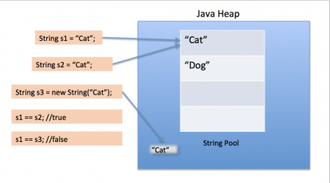
String Pool
String Pool in java is a pool of Strings stored in Java Heap Memory. Used to save space in memory.
When we use double quotes to create a String, it first looks for String with same value in the String pool, if found it just returns the reference else it creates a new String in the pool and then returns the reference

Slide 341
what is acceptance criteria and who writes?

Slide 342
groupId and artifactId

Slide 343
how do you resolve merge conflict?

Slide 344
UNION vs JOIN

Slide 345
Wrapper Class

Slide 346
Equivalence Partitioning

Slide 347
Synchronized?

Slide 348
What is thread safe?

Slide 349
When you run smoke test, how long does it take to run?

Slide 350
How many queries have you written? How often do you write them?

Slide 351
Where do you run smoke test from? Is it locally or somewhere else?

Slide 352
How many scripts do you run on the smoke test?

Slide 353
What you don't want to see in a organization/team?

Slide 354
How do you use Selenium Grid?

Slide 355
Difference between HashMap, HashSet, HashTable

Slide 356
How do you create "Bug" in JIRA?

Slide 357
What are enums? Are they classes or interface? Do you use them in your framework?
not current project but in my previous framework my Driver class, in which I launched the driver, i used enum it is a smarter way in switch cases
you only can use what ever you declared in enum. nothing else.

Slide 358
How many task cases you perform per sprint
10-15

Slide 359
What is Thread-safe or Synchronized?

Slide 360
iterator vs for each loop
Iterator works with array list and not array.
It will help us iterate through the elements.
Difference is with iterator you can make changes(remove item) to the list while iterating.
Within for each loop- we cannot make changes to our list.

Slide 361
How do you run your regression?
we make sure test data and environments are ready.
I execute my scripts and monitor the process, and once I get the result I analyze the results.
It could be cuased by script, environment or application issue. If its an application issue then I will have to reproduce the defect multiple times to ensure its an application issue.

Slide 362
How would you rate yourself in Java
As you may agree Java is like an ocean, there are alots of specific detailed topics, but I am comfortable with string manipulation, collections, quite familiar with OOP concepts and exception handling.

Slide 363
How do you handle multiple windows
I use getwindowhandle and getwindowhandles
these two methods returns unique codes for each windows opened.
Set<String> set = driver.getwindowhandles;
Then by using
driver.switchTo().window(uniquecode) I can land any page I want.
How do I do that
I store all the unique codes of the pages into Set collection,
Then I build an enhanced loop with the set,
In side the loop I can switch to the pages one by one,
lets say the title of the page I want to work on is abcd,
then I put I contidion after switching to page
for(String s:Set<String> list){
driver.switchTo().window(uniquecode)
if driver.getTitle().equals("abcd"){;
break }}
thats it I am on that page now, and I can start working on that page

Slide 364
POST vs PUT
"PUT" puts a file or resource at a particular URI and exactly at that URI. If there is already a file or resource at that URI, PUT changes that file or resource. If there is no resource or file there, PUT makes one
POST sends data to a particular URI and expects the resource at that URI to deal with the request. The web server at this point can decide what to do with the data in the context of specified resource
PUT is idempotent meaning, invoking it any number of times will not have an impact on resources.
However, POST is not idempotent, meaning if you invoke POST multiple times it keeps creating more resources

Slide 365
What is URI?
URI stands for Uniform Resource Identifier. It is a string of characters designed for unambiguous identification of resources and extensibility via the URI scheme.
The purpose of a URI is to locate a resource(s) on the server hosting of the web service.
A URI’s format is
<protocol>://<service-name>/<ResourceType>/<ResourceID>.

Slide 366
Why Page Object Model
==>Page object model --> a design pattern in selenium. in page object model, we mirror each page of the application in separate classes.
PageFactory is a class in selenium. It is used to achieve page object model design, it helps initialize the page objects in the class using initElements methods. When I create an object from the page class, pagefactory initializes the webelements (belonging to that page) that I will interact with.
==Advantages of using Page Object Pattern:
Easy to Maintain
Easy Readability of scripts
Reduce or Eliminate duplicacy
Re-usability of code
Reliability

Slide 367
Collection vs Collections?
Collection is an interface.
Collection col=new ArrayList();
Collections is a class. Collections.sort();

Slide 368
implicit casting vs explicit casting?
- Implicit Casting:
int i = 100;
double d = i;
- Explicit Casting:
int n = 12;
byte b = (byte)n;
- Auto - Boxing
Integer num = n;
- Un - Boxing
int j = num;

Slide 369
Super. VS Super()
super.
is used to access parent/super class members vars, methods
super()
is used to call super class constructor

Slide 370
this. vs this()
- this.
this object by using this. we can access instance variables and
method. to differentiate between instance and argument variable
- this()
call a constructor from another constructor in same class
Example:
public class computer{
private String brand;
public computer(){
this("apple");
}
public computer (String brand){
this.brand = brand; }}

Slide 371
How do you launch the browser

Slide 372
How do you start automation

Slide 373
Java
Java was developed by a team led by James Gosling at Sun Microsystems. Sun Microsystems was purchased by Oracle in 2010. Originally called Oak, Java was designed in 1991 for use in embedded chips in consumer electronic appliances. In 1995, renamed Java, it was redesigned for developing Web applications.
Java has become enormously popular. Its rapid rise and wide acceptance can be traced to its design characteristics, particularly its promise that you can write a program once and run it anywhere.
As stated by its designer, Java is simple, object oriented, distributed, interpreted, robust, secure, architecture neutral, portable, high performance, multi- threaded, and dynamic.

Slide 374
Naming Conventions

